Slide 1

Lecture 11 – Machine Translation
Baojian Zhou
DATA130030.01 (自然语言处理)
School of Data Science Fudan University
05/24/2023
Notes:
Machine Translation

Slide 2
Outline
Introduction of MT
Methods
Word-Based Models & Phrase-Based Models
Encoder-Decoder Models
Evaluation
Notes:
针对机器翻译任务，如何对模型进行评估机是一个非常值得讨论的话题，
如果你找到一群机器翻译研究人员并互相交谈，你会注意到他们最后都会谈论模型的评估。
翻译评估问题很难，甚至难道不可能有效评估。

Slide 3
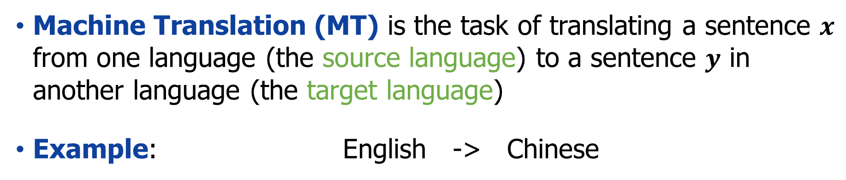
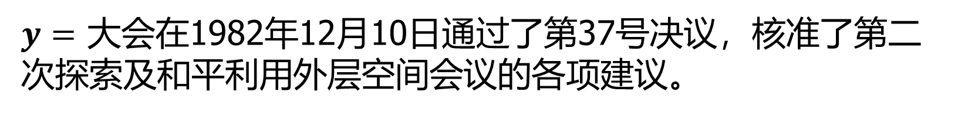
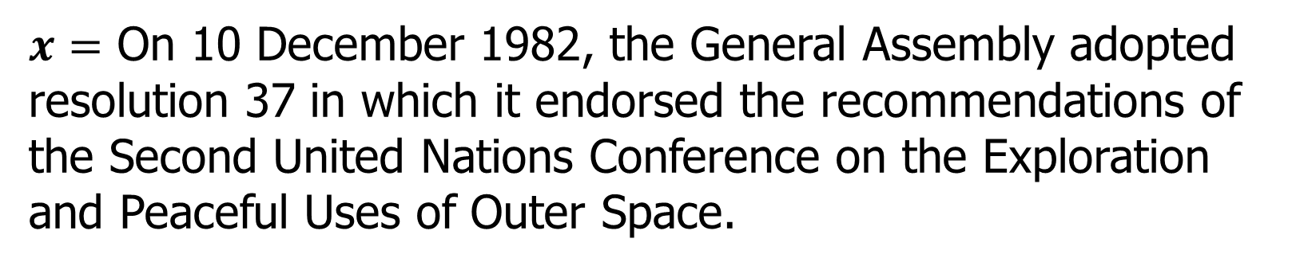
Machine Translation
Machine Translation (MT) is the task of translating a sentence $x$ from one language (the source language) to a sentence $y$ in another language (the target language)
Example: English -> Chinese
$x=$ On 10 December 1982, the General Assembly adopted resolution 37 in which it endorsed the recommendations of the Second United Nations Conference on the Exploration and Peaceful Uses of Outer Space.
$y=$ 大会在1982年12月10日通过了第37号决议，核准了第二次探索及和平利用外层空间会议的各项建议。
Notes:
机器翻译是将句子 x 从一种语言，我们叫源语言，翻译成另一种语言，我们目标语言的句子 y。

Slide 4
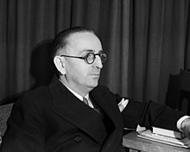
An Old Idea
Computers emerged during World War II was code-breaking, the foreign armies encoded the messages in deliberate codes and breaking these codes is a really important problem.
Warren Weaver on translation as code breaking (1947):
When I look at an article in Russian, I say: ”This is really written in English, but it has been coded in some strange symbols. I will now proceed to decode”.
Warren Weaver (July, 1894 – November, 1978) was an American scientist, mathematician, and science administrator. He is widely recognized as one of the pioneers of machine translation.
Notes:
有一定的历史背景：第二次世界大战期间出现的计算机是密码破解，外国军队将信息编码成故意的密码，破解这些密码是一个非常重要的问题。
Warren Weaver是美国科学家、数学家和科学管理员。 他被广泛认为是机器翻译的先驱之一，也是在美国为科学创造支持的重要人物。
把翻译当成是一个密码破解的问题。

Slide 5

1950s: Early Machine Translation
Notes:
俄语 -> 英语 1 分钟视频显示 1954 MT（受冷战启发！）乔治城大学和 IBM 联合开发

Slide 6
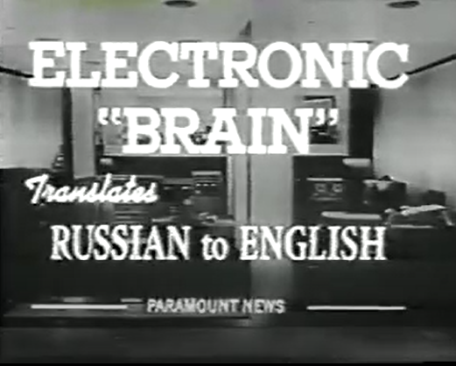
1950s: Early Machine Translation
Machine Translation research began in the early 1950s.
Systems were mostly rule-based, using a bilingual dictionary to map Russian words to their English counterparts
First MT conference was held in London (1956)
Electronic “Brain” translates Russian to English.
----------------- Paramount News ------------------
Note: Paramount News is the name on the newsreels produced by Paramount Pictures from 1927 to 1957.

Slide 7
Rule-based machine translation
Rule-based machine translation (RBMT) is a MT approach based on hardcoded linguistic rules.
Monolingual and bilingual dictionaries to map input words to output words
Rules that represent the source language structure
Rules that represent the target language structure
Rule-based MT is challenging because it demands time and effort.
Rule-based systems are not scalable because rules must be manually written. Improvements require more rules and more human involvement.
Notes:
基于规则的机器翻译 (RBMT) 是一种基于硬编码语言规则的机器翻译方法。
单语和双语词典将输入词映射到输出词
表示源语言结构的规则
表示目标语言结构的规则
基于规则的机器翻译具有挑战性，因为它需要时间和精力。
基于规则的系统不可扩展，因为必须手动编写规则。 改进需要更多的规则和更多的人为参与。

Slide 8
Rule-based machine translation
Rule-based systems
build dictionaries
write transformation rules
refine, refine, refine
Meteo system for weather forecasts (1976)
Systran (1968), Logos and Metal (1980s)
"have" :=
if
subject(animate) and object(owned-by-subject)
then
translate to "kade... aahe"
if
subject(animate) and object(kinship- with-subject)
then
translate to "laa... aahe"
if
subject(inanimate)
then
translate to "madhye... aahe"
Notes:
METEO 系统是一个机器翻译系统，专门用于翻译加拿大环境部每天发布的天气预报。 从 1981 年到 2001 年 9 月 30 日，加拿大环境部使用该系统将魁北克省以法语发布的预报翻译成英语，并将加拿大其他省份以英语发布的预报翻译成法语。
SYSTRAN 由 Peter Toma 博士于 1968 年创立，是历史最悠久的机器翻译公司之一。 SYSTRAN 为美国国防部和欧盟委员会做了大量工作。

Slide 9
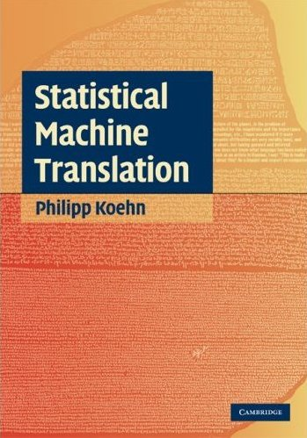
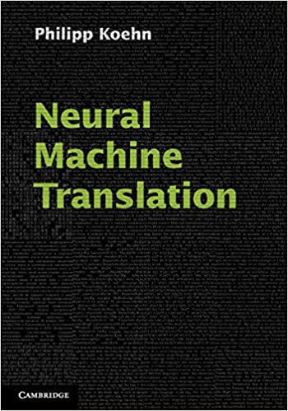
Recent development on learning MT models
Statistical Machine Translation
1980s: IBM
1990s: increased research
Mid 2000s: Phrase-Based MT (Moses, Google)
Around 2010: commercial viability
Neural Machine Translation
Late 2000s: neural models for computer vision
Since mid 2010s: neural models for machine translation
2016: Neural machine translation the new state of the art
Notes:
统计机器翻译
1980 年代：IBM
1990 年代：增加研究
2000 年代中期：基于短语的 MT（摩西，谷歌）
2010年前后：商业可行性
神经机器翻译
2000 年代后期：计算机视觉的神经模型
自 2010 年代中期以来：机器翻译的神经模型
2016 年：神经机器翻译的最新技术

Slide 10
Machine Translation hype cycle
Based on Philipp Koehn’s impressions, not hard facts.
Neural MT
Georgetown experiment
Hype
Statistical MT
Expert systems / 5th generation AI
Reality
1950 1960 1970 1980 1990 2000 2010 2020
Notes:
模型图：基于 Philipp Koehn 的印象，而非确凿的事实。
Georgetown-IBM 实验是 1954 年 1 月 7 日进行的一次有影响力的机器翻译示范。该实验由乔治城大学和 IBM 联合开发，涉及将 60 多个俄语句子完全自动翻译成英语。
机器翻译 (MT) 炒作周期。 在其历史的大部分时间里，对机器翻译质量的期望要么高估要么低估了质量方面的真正进步，从而形成了研发的繁荣与萧条周期。 尽管如此，机器翻译在过去的 20 年里已经成为现实。 （注：图表基于我的主观印象，而非事实。）

Slide 11
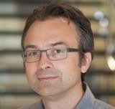
Google Translate
Launched in April 2006 as a statistical MT service, it used United Nations and European Parliament documents and transcripts to gather linguistic data.
In November 2016, Google announced that Google Translate would switch to a neural machine translation engine – Google Neural Machine Translation (GNMT) – which translates "whole sentences at a time, rather than just piece by piece.
Statistical machine translation live
Friday, April 28, 2006
Posted by Franz Och, Research Scientist Because we want to provide everyone with access to all the world's information, including information written in every language, one of the exciting projects at Google Research is machine translation. Most state-of-the-art commercial machine translation systems in use today have been developed using a rules-based approach and require a lot of work by linguists to define vocabularies and grammars. Several research systems, including ours, take a different approach: we feed the computer with billions of words of text, both monolingual text in the target language, and aligned text consisting of examples of human translations between the languages. We then apply statistical learning techniques to build a translation model. We have achieved very good results in research evaluations. Now you can see the results for yourself. We recently launched an online version of our system for Arabic-English and English-Arabic. Try it out! Arabic is a very challenging language to translate to and from: it requires long-distance reordering of words and has a very rich morphology. Our system works better for some types of text (e.g. news) than for others (e.g. novels) -- and you probably should not try to translate poetry ... but do stay tuned for more exciting developments. Update: We've just opened a discussion forum for all topics related to machine translation. Update: Fixed broken link to NIST results.
Notes:
KN sampling →, 德国人，博士导师是Hermann Ney,把大家搞崩溃的KN smoothing算法的发明人。他一直从事机器翻译工作。
它于 2006 年 4 月作为统计机器翻译服务推出，它使用联合国和欧洲议会的文件和成绩单来收集语言数据。
2016 年 11 月，谷歌宣布谷歌翻译将改用神经机器翻译引擎——谷歌神经机器翻译 (GNMT)——它一次翻译整个句子，而不是逐句翻译。

Slide 12
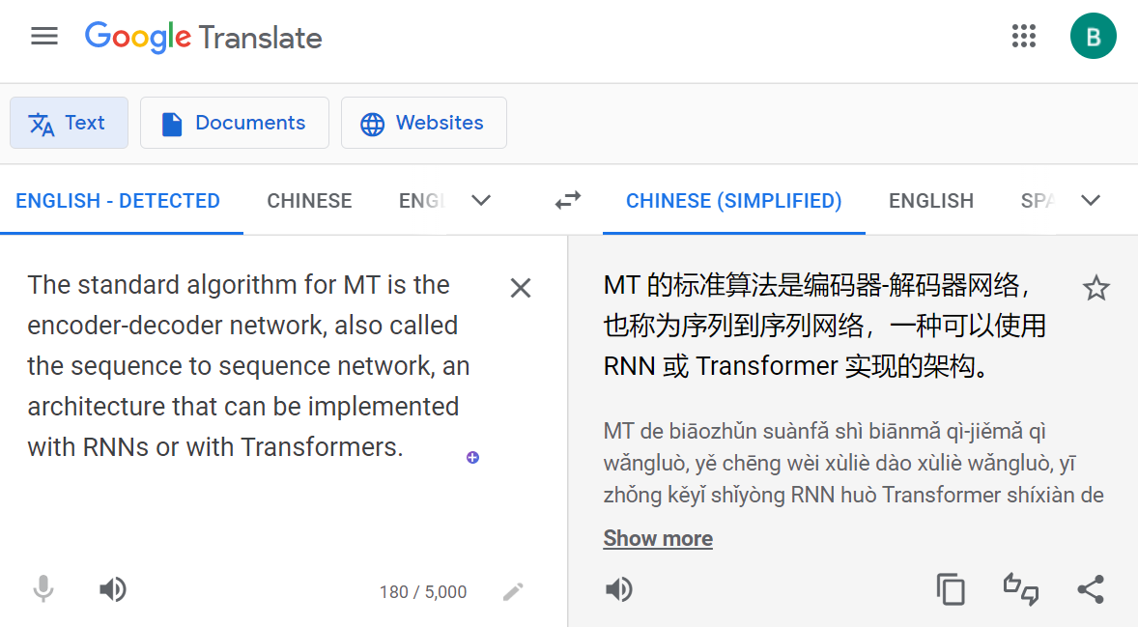
Google Translate (Accessed in 2022)
As of May 2023, Google Translate supports 133 languages at various levels, and as of April 2016, claimed over 500 million total users, with more than 100 billion words translated daily.
Notes:
谷歌翻译是谷歌开发的一种多语言神经机器翻译服务，用于将文本、文档和网站从一种语言翻译成另一种语言。
截至 2022 年 5 月，谷歌翻译支持 109 种不同级别的语言，截至 2016 年 4 月，总用户数超过 5 亿，日翻译量超过 1000 亿字。

Slide 13
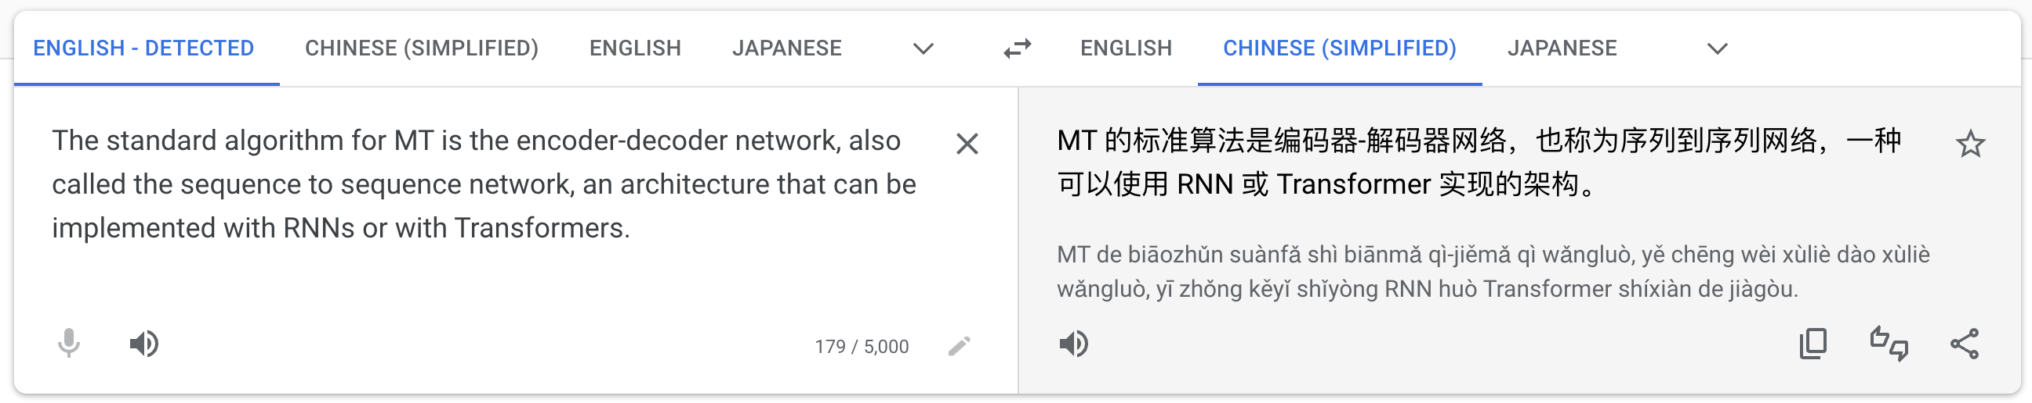
Google Translate (Accessed in 2023)
Notes:
谷歌翻译是谷歌开发的一种多语言神经机器翻译服务，用于将文本、文档和网站从一种语言翻译成另一种语言。
截至 2022 年 5 月，谷歌翻译支持 109 种不同级别的语言，截至 2016 年 4 月，总用户数超过 5 亿，日翻译量超过 1000 亿字。

Slide 14
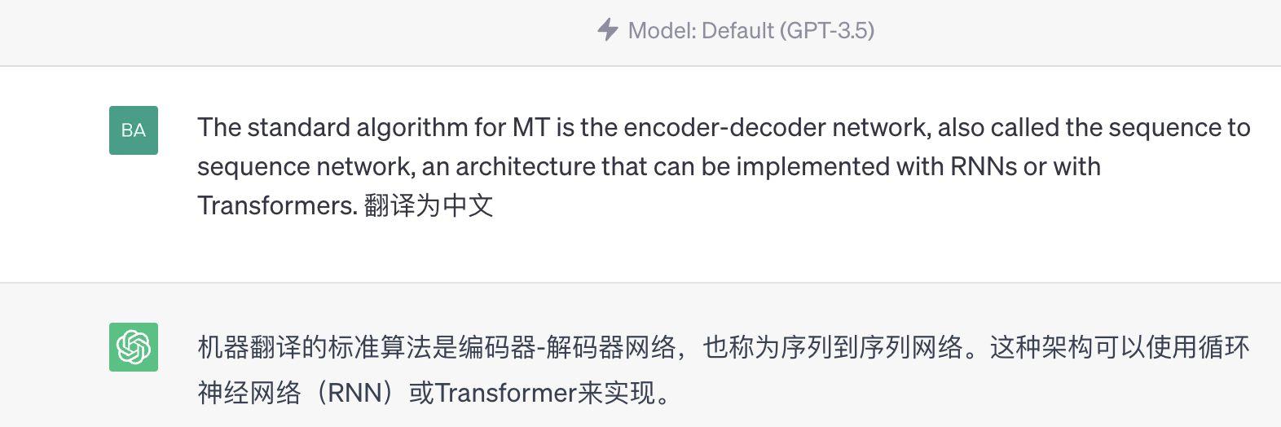
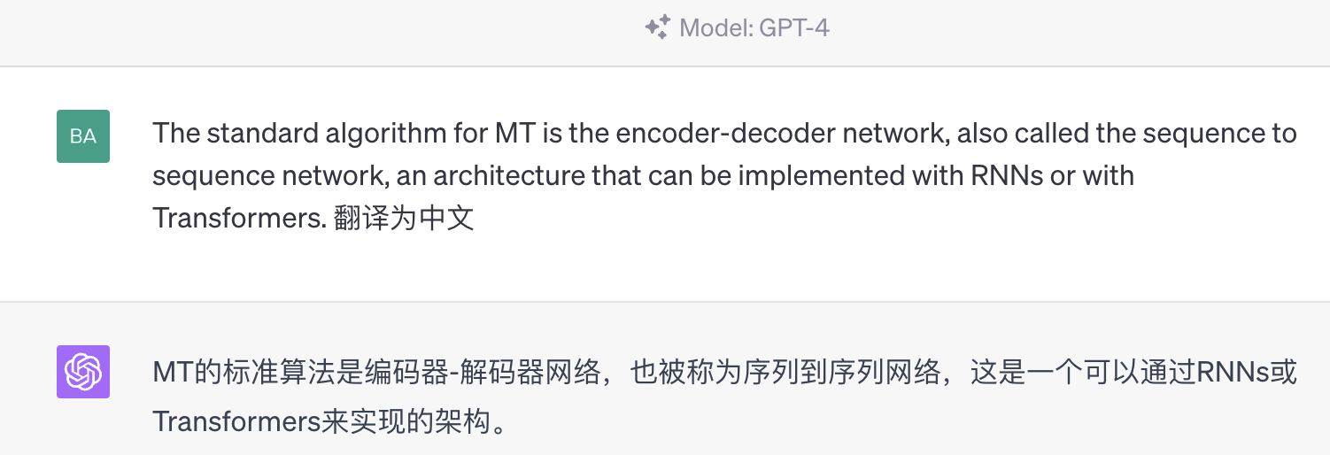
ChatGPT & GPT-4 (Accessed in 2023)

Slide 15
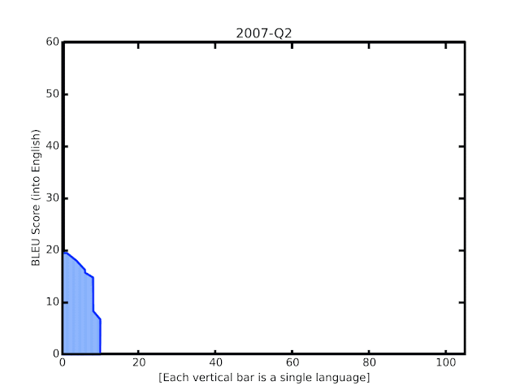
MT papers
Google Scholar search “neural machine translation”: https://scholar.google.com/scholar?q=%22neural+machine+translation%22&as_ylo=2017&as_yhi=2017

Slide 16
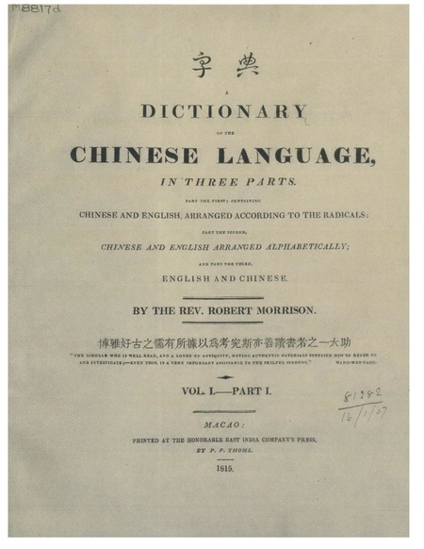
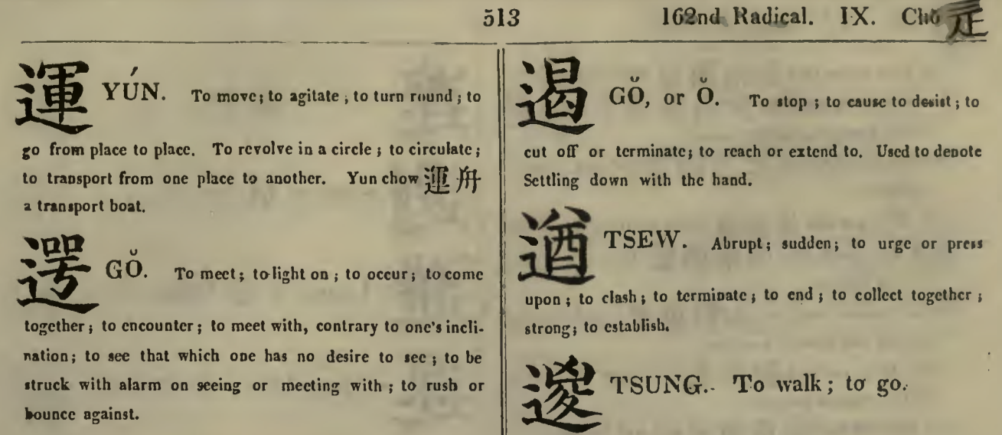
First Chinese-English Dictionary
A Dictionary of the Chinese Language, in Three Parts or Morrison's Chinese dictionary (1815-1823), compiled by Robert Morrison was the first Chinese-English, English-Chinese dictionary. Part I is Chinese-English arranged by the 214 Kangxi radicals, Part II is Chinese-English arranged alphabetically, and Part III is English-Chinese also arranged alphabetically.
Notes:
第一版汉英，英汉字典的介绍。
博雅好古之儒有所據（据）以爲（为）考究斯亦善讀書（书）者之一大助。The scholar who is well read, and a lover of antiquity, having authentic materials supplied him to refer to and investigate; - Even this, is a very important assistance to the skilful student。
繁体字的翻译难度很大。

Slide 17
Example of Chinese-English Translation
Chinese input
伦敦每日快报指出，两台记载戴安娜王妃一九九七年巴黎死亡车祸调查资料的手提电脑，被从前大都会警察总长的办公室里偷走。
Statistical machine translation
The London Daily Express pointed out that the death of Princess Diana in 1997 Paris car accident investigation information portable computers, the former city police chief in the offices of stolen. (SMT Book, Philipp Koehn, between 2006 and 2009)
Neural Machine Translation
The Daily Express of London said two laptops containing information on the investigation into Princess Diana‘s death in Paris in 1997 had been stolen from the office of the former Metropolitan Police chief. (Google Translate, May, 2022)
Human translation
London’s Daily Express noted that two laptops with inquiry data on the 1997 Paris car accident that caused the death of Princess Diana were stolen from the office of a former metropolitan police commissioner. (SMT Book, Philipp Koehn, from 2006 NIST)
Notes:
这是一个在2009年时候,SMT 书里面，被认为非常难的句子。
Neural Machine Translation 更能够接近真实的人工翻译
The 和 a 的区别。
The Commissioner of Police of the Metropolis is the head of London‘s Metropolitan Police Service. 警察总长和警察专员有时候可以互换。

Slide 18
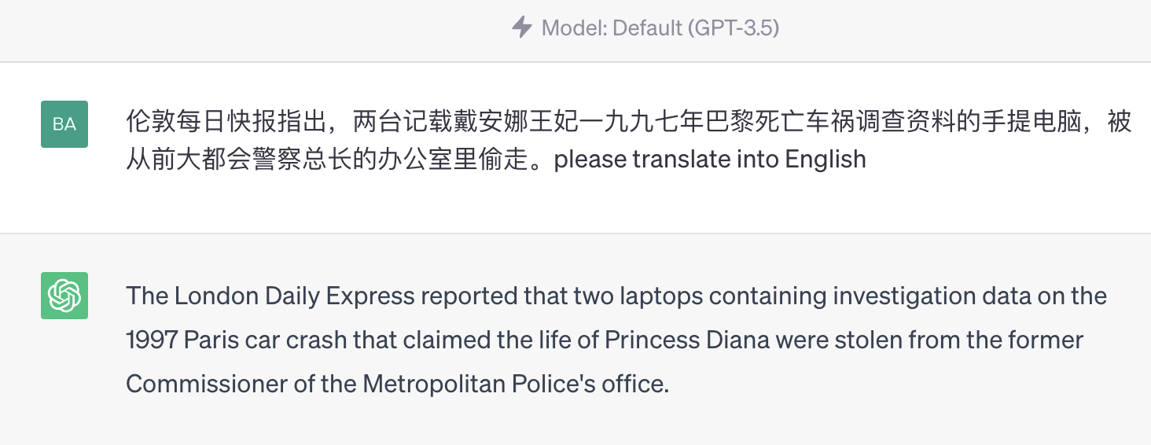

Example of Chinese-English Translation
ChatGPT
GPT4

Slide 19
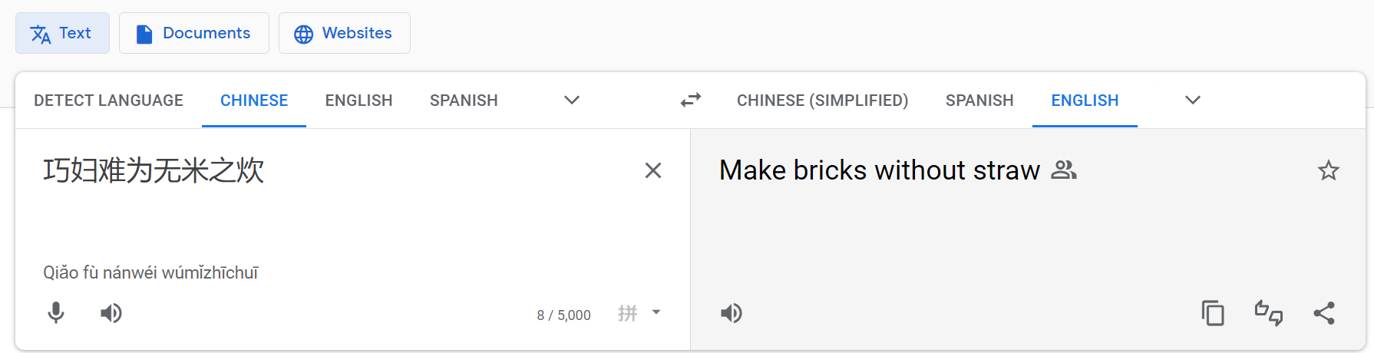
MT is hard!
It is often impossible to produce quality translation.
Example of a Chinese input:
巧妇难为无米之炊
Formal correspondence
Even the cleverest woman cannot cook a meal without rice.
Better Idioms and phrases
One cannot make bricks without straw.
Google Translate
Make bricks without straw
Notes:
更好的成语和短语、比喻、俗语
没有稻草的砖是一个短语，指的是在没有适当资源的情况下必须完成的任务。
除非您拥有基本的必要工具或材料，否则您无法制作或做某事。 除非他们开始招募真正优秀的球员，否则你永远不会拥有一支冠军球队。
然而，英语语言的接受者很难理解为什么他们需要米饭来做饭的文化方面。 翻译成英文可能会有问题，因为说英语的人通常不以大米为主食，更重要的是，它会被视为反女权主义者。
动态等价方法（Eugene A. Nida，1914-2011）
Bricks without straw is a phrase that refers to a task which must be undertaken without appropriate resources.
You can't make or do something unless you have the basic necessary tools or materials. You're never going to have a championship team unless they start recruiting players who are actually any good.
However, receptors of the English language would have a hard time understanding the cultural aspect as to why they would need rice to make a meal. The translation might be problematical in English since English-speakers usually do not have rice as a staple food, more importantly, it would be perceived as anti-feminist.
Dynamic equivalence method (by Eugene A. Nida, 1914-2011)

Slide 20
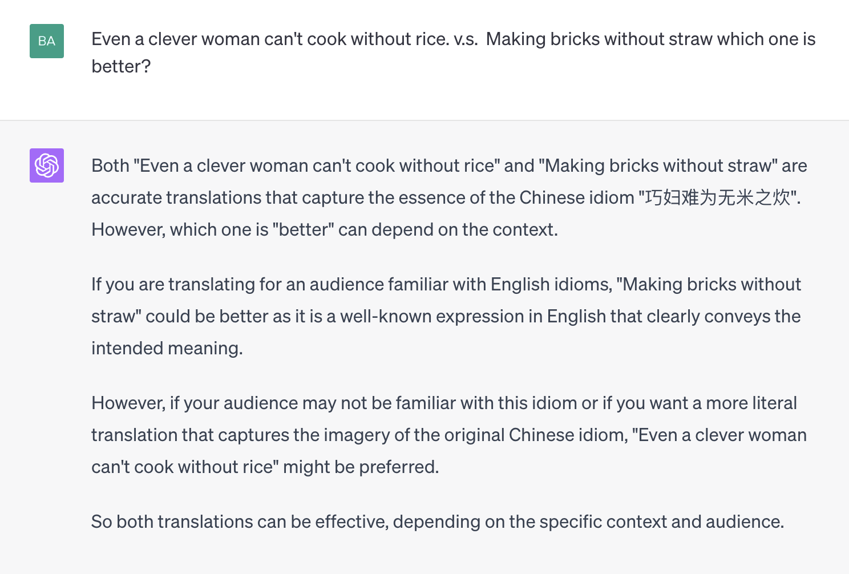
MT is hard!

Slide 21

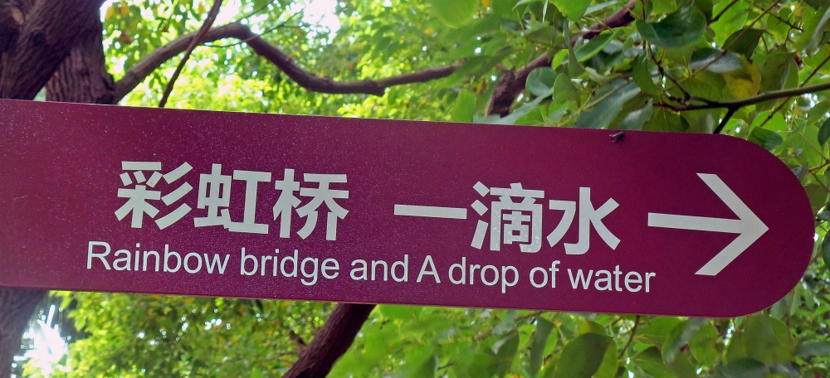
MT is hard!
Chinglish can be defined as the mistranslation of the English language that is influenced by the Chinese culture and language.

Slide 22
MT is hard!
$x=$ On 10 December 1982, the General Assembly adopted resolution 37 in which it endorsed the recommendations of the Second United Nations Conference on the Exploration and Peaceful Uses of Outer Space.
$y=$ 大会在1982年12月10日通过了第37号决议，核准了第二次探索及和平利用外层空间会议的各项建议。
English and Chinese are differ in many ways:
Ordering differs in major ways, English: “the recommendations of the Second United Nations Conference”. Chinese: 第二次联合国会议的建议
The date is ordered differently
English requires “the” ( 4 times)
English marks plurality on nouns. Chinese must use the modifier 各项/various
English capitalizes some words

Slide 23
Word order typology
Languages differ in the basic word order of verbs, subjects, and objects in simple declarative clauses.
SVO (Subject-Verb-Object) languages: German, French, English, and Mandarin.
Hindi and Japanese, by contrast, are SOV languages.
Irish and Arabic are VSO languages.
Two languages that share their basic word order type often have other similarities.
English: He wrote a letter to a friend
Japanese: tomodachi ni tegami-o kaita
Translated: friend to letter wrote
Notes:
词序类型
语言在简单的陈述句中动词、主语和宾语的基本词序不同。
例如，德语、法语、英语和普通话都是（主语-动词-宾语）语言，这意味着动词往往位于主语和宾语之间。
相比之下，印地语和日语是 SOV 语言，这意味着动词往往出现在基本从句的末尾，爱尔兰语和阿拉伯语是 VSO 语言。
共享其基本词序类型的两种语言通常具有其他相似之处。 例如，VO 语言一般有介词，而 OV 语言一般有后置词。

Slide 24
Lexical Divergences
Coreference problem
Cousin: a child of one's uncle or aunt
How to translate cousin into Chinese? Male or female?
Dad’s brother’s son (if older than you) – 堂兄
Dad’s brother’s son (if younger than you) – 堂弟
Dad’s brother’s daughter (if older than you) – 堂姐
… 堂妹、表哥、表弟、表姐、表妹…
Complex inference required
Whenever I visit my uncle and his daughters,
I can’t decide who is my favorite cousin.
Notes:
词汇分歧
语义翻译问题中的共同指代问题：
英语使用兄弟一词来表示任何男性兄弟姐妹，而中文和许多其他语言对哥哥和弟弟有不同的词（分别为普通话哥哥和弟弟）。

Slide 25
Word Translation Problems
Words are ambiguous
How do we find the right meaning, and thus translation?
Context should be helpful.
He deposited money in a bank account with a high interest rate.
Sitting on the bank of the Mississippi, a passing ship piqued his interest.
Notes:
那么为什么这是一个好计划。让我们先看看在翻译过程中会遇到的一些问题，我们从单词翻译开始。
问题词是模棱两可的，所以这里的经典例子是bank 银行这个词和interest利息这个词，它们在这些句子中的含义截然不同。
第一句话He deposited money in a bank account with a high interest rate. 他将钱存入利率较高的银行账户。这里涉及钱、账户，所以bank和interest翻译成中文是银行和利息。
另一句话是Sitting on the bank of the Mississippi, a passing ship piqued his interest. 坐在密西西比河的岸上, 一艘过往的船激发了他的兴趣，这里的岸边是一条河的岸边。与金融机构无关，这里的兴趣也没有经济意义，它只是意味着一种好奇心，这些是非常不同的含义。所以，如果我们把这些单词翻译成中文时，我们可能会实际上必须为翻译选择不同的单词。
所以计算机如何判断第一句中的银行与第二句中的银行不同。那么你怎么知道第一句中的银行与第二句中的银行不同。知道它是因为您只需查看周围的单词，并且从上下文中很清楚这些单词的含义和含义。该上下文也可用于计算机，并且其中一些上下文也应该有助于计算机进行翻译。
so why is that a good plan. let‘s first look at some of the problems that we will encounter during translation we’ll start with word translation. problems words are ambiguous so the classic examples here are the word interest and the word bank these have starkly different meanings in these sentences so the first sentence they deposited money in a bank account with a higher interest rate. you have bank here as a financial institution and interest rate as you know the fee that's being paid for a loan and the other sentence is sitting on the bank of the Mississippi. a passing ship peaked his interest where bank here is the shore of a river which. has nothing to do with the financial institution and the interest here also has no financial meaning it just means a sense of curiosity these are very different meanings and in many languages they might have very different translations so if i translate this into chinese into german i might actually have to pick different words for the translations so how is a computer gonna figure out that bank in the first sentence is different from bank in the second sentence. well how do you know that bank in the first sentence is different from bank in the second sentence you. know it because you just look at the surrounding words and from the context it's pretty clear what the meaning of these words are and. that context is also available to a computer and some of that context should also help a computer to translate

Slide 26
Semantic Translation Problems
Discourse
How to translated since? Temporal or conditional?
Analysis of discourse structure – a hard problem.
Since you brought it up, I do not agree with you.
Since you brought it up, we have been working on it.
Notes:
语义翻译问题中的discourse分析, 即话语分析。这里的另一个语义翻译问题与话语有关。
在这里我们有两个子句：Since you brought it up, I do not agree with you. 这里的“since”更像是推理，推论。 “因为你提出了它，我想指出我不同意你的看法” 。所以准确的翻译是：“既然你提出来了，我不同意你的看法”。
第二个句子，Since you brought it up, we have been working on it “自从你提出以来，我们一直在努力”。 这更像是“自从”，当你提出这个问题时，我们一直在努力解决这个问题。 所以“since”更像是一种暂时的感觉。 既然你第一个句子你可以用because替换它，第二个句子就你不能，这个词可能有不同的翻译。
所以，选择什么样的翻译含义要来自话语结构本身的分析，那么这也是比较难的。

Slide 27
Referential density
Languages that can omit pronouns are called pro-drop languages.
这 块 蛋糕 很 好吃。 谁 烤 的？
This piece cake DEGREE tasty. Who bake MODIFY
This cake is tasty. Who baked (it)?
不 知道。 喜欢 吗？
Not know. Like Q?
(I) don’t know. Do (you) like (it)?
Notes:
指代密度问题，可以省略代词的语言称为pro-drop 语言。中文翻译是：主语脱落(pro-drop)语言

Slide 28
How can we build a MT model?
A Clear Plan
Interlingua
Analysis
Generation
Semantic Transfer
Syntactic Transfer
Lexical Transfer
Source
Target
The Vauquois triangle (Vauquois, 1968)
Notes:
那么我们怎么让机器去做翻译，有没有一个总体的原则可以遵循？
让我们首先从一个角度来看这个机器翻译问题，这是一个已经存在很长时间的 Vauquois 三角关系图，并且被认为是构建机器翻译系统的原则性关系图。
我们可以想出一个源语言中的句子 Source language，然后通过将所有单词翻译成目标语言单词，词汇转换，也许我们需要一些关于重新排序的规则，但想法的本质是单词映射问题，是我们应该重点关注的。
仅仅关注单词层面是不够的，实际上，我们应该做一些语言分析，（句法转换），这也就意味着，检测什么是名词、什么是动词、什么是从句、句子的主语在哪里、如何把主语与句子的宾语隔开。
如果您知道这些句法规则是什么，我们就可以找到一些合理的方法来映射语言之间的句法结构。
但是句法转移、句法转换仍然在句子层面，表面的可见部分上进行，其实我们真正想要翻译的是句子的真正含义。所以，如果我们可以获取源语句的含义表示，即我们的语义转移/语义转换，这样的话，我们的转换后的语句可能就会更贴近目标语言，显得含义方面更贴切。
我们的最终目标是 Interlingua 国际语翻译，国际语的表示 representation。
这个三角表示图是一个很好的motivation，我们的终极目标就是要打通这些箭头。
有各种各样的语言，都可以把他们表示成国际语言表示，翻译的时候只要找到对应最好的国际语言表示。

Slide 29
General ideas – Learning from data
Training
Using
Source Text
Training Data
Parallel corpora, monolingual corpora, dictionaries
Linguistic Tools
Machine Translation System
Machine Translation System
Translation
Notes:
另一个重要的想法是从数据中学习。 这个想法是，一方面我们有训练数据，包括平行语料库，翻译文本的单语语料库，即任何文本，以及所涉及的字典，也许还有语言工具，它帮我们收集统计数据以构建机器翻译系统。
想要使用它的时候，我们提供源文本通过统计机器翻译系统运行并生成翻译，因此这里的关键是，我们构建的系统是从数据中学习
平行文本是与译文并行放置的文本。平行文本对齐 是指确定平行文本中原文和译文的对应句子。平行文本的集合被称为平行语料库。在句子层面对齐平行语料库是很多语言学研究领域的前提条件。
the other big idea is to learn from data. so the idea is that you have training data on one hand parallel corpora so translated text monolingual corpora. these are just any text and the languages involved dictionaries and maybe also linguistic tools and that allows you to kind of collect the statistics to build a machine translation system and then at run time when you actually want to use it. you just put take the source text run it through the statistical machine translation system and produce a translation so the key here is you learn from data

Slide 30
Outline
Introduction
Methods
Word-Based Models & Phrase-Based Models
Encoder-Decoder Models
Evaluation
Notes:
针对机器翻译任务，如何对模型进行评估机是一个非常值得讨论的话题，如果你找到一群机器翻译研究人员并互相交谈，你会注意到他们最后都会谈论模型的评估。翻译评估问题很难，甚至难道不可能有效评估。

Slide 31
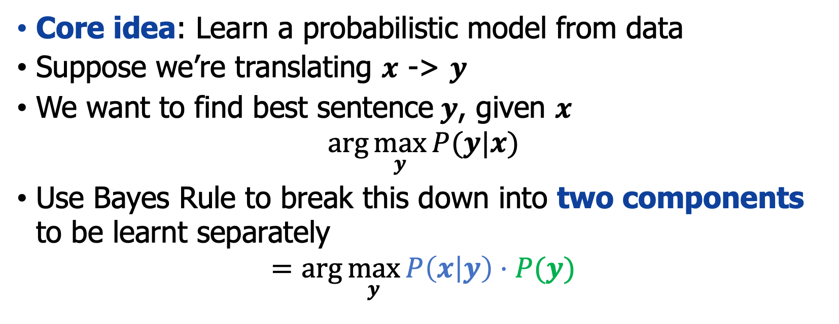
1990s-2010s: Statistical MT
Core idea: Learn a probabilistic model from data
Suppose we’re translating $x$ -> $y$
We want to find best sentence$y$, given $x$
$$\arg{\max_{y}{P(y|x)}}$$
Use Bayes Rule to break this down into two components to be learnt separately
$$=\arg{\max_{y}{P\left(x | y\right)⋅P(y)}}$$
Translation Model
Models how words and phrases should be translated (fidelity). Learnt from parallel data.
Language Model
Models how to write good English (fluency). Learnt from monolingual data.
Notes:
示范如何写好英语（流利）。 从单语数据中学习。
模拟单词和短语的翻译方式（保真度）。 从并行数据中学习。
语言模型
示范如何写好英语（流利）。 从单语数据中学习。

Slide 32
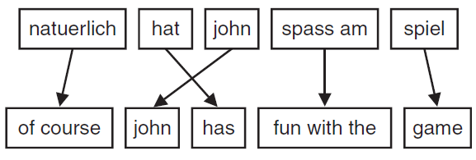
1990s-2010s: Statistical MT
Word-Based Models
The initial statistical models for machine translation are based on words as atomic units that may be translated, inserted, dropped, and reordered.
Phrase-Based Models
The input is segmented into phrases (not necessarily linguistically motivated), translated one-to-one into phrases in English and possibly reordered.
Notes:
机器翻译的初始统计模型基于单词，单词之间可以直接翻译、插入、删除和重新排序的原子单元。
目前最成功的机器翻译方法将短语翻译作为原子单位。

Slide 33
1990s-2010s: Statistical MT
SMT was a huge research field
The best systems were extremely complex (e.g. Hundreds of important details)
Systems had many separately-designed subcomponents
Lots of feature engineering: Need to design features to capture particular language phenomena
Require compiling and maintaining extra resources (e.g. tables of equivalent phrases)
Lots of human effort to maintain: Repeated effort for each language pair!
Notes:
SMT是一个巨大的研究领域
最好的系统极其复杂（例如数百个重要细节）
系统有许多单独设计的子组件
大量特征工程：需要设计特征来捕捉特定的语言现象
需要编译和维护额外的资源（例如等效短语表）
维护大量人力：为每个语言对重复努力！

Slide 34
Outline
Introduction
Methods
Word-Based Models & Phrase-Based Models
Encoder-Decoder Models
Evaluation
Notes:
针对机器翻译任务，如何对模型进行评估机是一个非常值得讨论的话题，如果你找到一群机器翻译研究人员并互相交谈，你会注意到他们最后都会谈论模型的评估。翻译评估问题很难，甚至难道不可能有效评估。

Slide 35
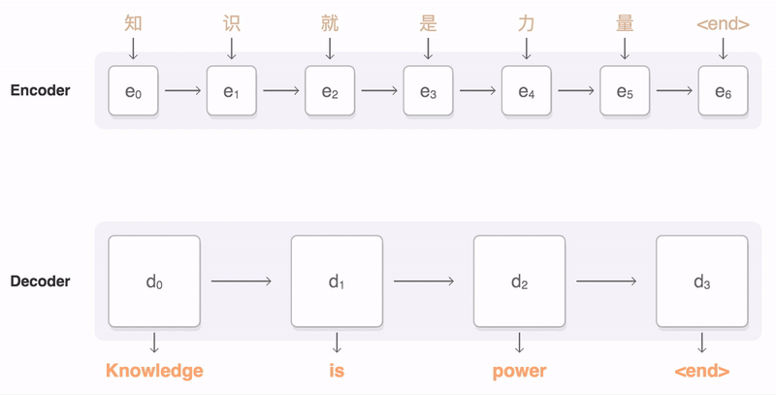
Neural Machine Translation (NMT)
Neural Machine Translation (NMT) is a way to do Machine Translation with neural networks.
The neural network architecture is called sequence-to-sequence (aka seq2seq) and it involves two RNNs.
Notes:
神经机器翻译 (NMT) 是一种使用单个神经网络进行机器翻译的方法。
神经网络架构称为序列到序列（又名 seq2seq），它涉及两个 RNN。

Slide 36
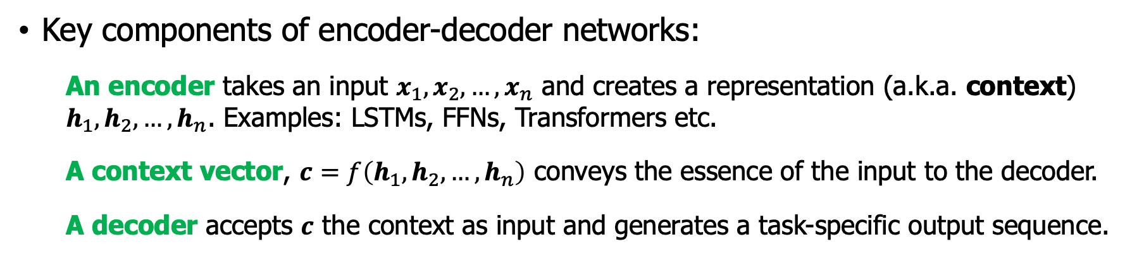
Encoder-decoder model
Key components of encoder-decoder networks:
An encoder takes an input $x_{1},x_{2},…,x_{n}$ and creates a representation (a.k.a. context) $h_{1},h_{2},…,h_{n}$. Examples: LSTMs, FFNs, Transformers etc.
A context vector, $c=f\left(h_{1},h_{2},…,h_{n}\right)$ conveys the essence of the input to the decoder.
A decoder accepts $c$ the context as input and generates a task-specific output sequence.
Output sequence $y_{1}$ $y_{2}$ $y_{3}$ $y_{n}$
Context is a function of the hidden
representations of the input, and may be used by the decoder in a variety of ways.
Decoder
Context
Encoder
Input sequence $x_{1}$ $x_{2}$ $x_{3}$ $x_{n}$
Notes:
编码器-解码器模型/网络或序列到序列网络是能够生成适合上下文的任意长度输出序列的模型。 编码器-解码器网络已经有非常广泛的应用，不仅包括机器翻译，还有生成文本摘要、问答和对话等。这些网络背后的关键思想是使用编码器网络，该网络接受输入序列并创建它的上下文表示，通常称为上下文。 然后将该表示传递给解码器，该解码器生成特定于任务的输出序列。 图中说明了该架构的组成部分。
这里强调一下：上下文是输入的隐藏表示的函数，并且可以由解码器以多种方式使用
编码器接受输入序列 x 并生成相应的上下文表示序列 h。 LSTM、卷积网络和 Transformer 都可以用作编码器
上下文向量 c，是输入的隐藏表示的函数，将输入的本质传达给解码器，并且可以由解码器以多种方式使用。
解码器接受 c 作为输入并生成任意长度的隐藏状态序列 h，从中可以获得相应的输出状态序列 y。 就像编码器一样，解码器可以通过任何类型的序列架构来实现

Slide 37
Outline
Introduction
Methods
Word-Based Models & Phrase-Based Models
Encoder-Decoder Models
Encoder-Decoder with RNNs
Evaluation
Notes:
针对机器翻译任务，如何对模型进行评估机是一个非常值得讨论的话题，如果你找到一群机器翻译研究人员并互相交谈，你会注意到他们最后都会谈论模型的评估。翻译评估问题很难，甚至难道不可能有效评估。

Slide 38
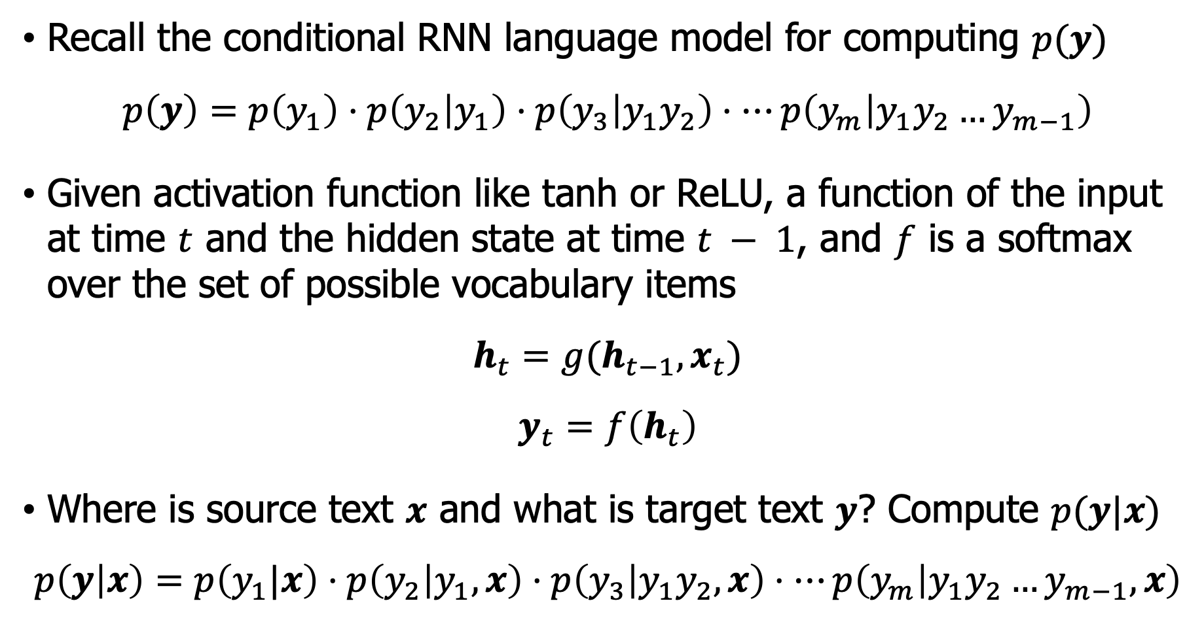
Encoder-Decoder with RNNs
Recall the conditional RNN language model for computing $p(y)$
$$p\left(y\right)=p\left(y_{1}\right)⋅p\left(y_{2} | y_{1}\right)⋅p\left(y_{3} | y_{1}y_{2}\right)⋅⋯p\left(y_{m} | y_{1}y_{2}…y_{m−1}\right)$$
Given activation function like tanh or ReLU, a function of the input at time $t$ and the hidden state at time $t − 1$, and $f$ is a softmax over the set of possible vocabulary items
$$h_{t}=g(h_{t−1},x_{t})$$
$$y_{t}=f\left(h_{t}\right)$$
Where is source text $x$ and what is target text $y$? Compute $p(y|x)$
$$p\left(y | x\right)=p\left(y_{1}|x\right)⋅p\left(y_{2} | y_{1},x\right)⋅p\left(y_{3} | y_{1}y_{2},x\right)⋅⋯p\left(y_{m} | y_{1}y_{2}…y_{m−1},x\right)$$
Notes:
给定像 tanh 或 ReLU 这样的激活函数，时间 𝑡 的输入和时间 𝑡 − 1 的隐藏状态的函数，𝑓 是可能词汇项集上的 softmax。

Slide 39
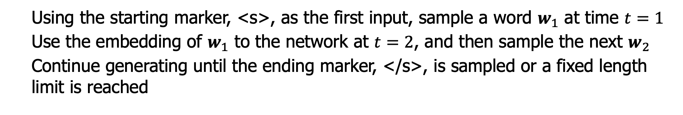
Autoregressive generation – get $y$
Using the starting marker, <s>, as the first input, sample a word $w_{1}$ at time $t=1$
Use the embedding of $w_{1}$ to the network at $t=2$, and then sample the next $w_{2}$
Continue generating until the ending marker, </s>, is sampled or a fixed length limit is reached
Sampled word So long and ?
Softmax
RNN
Embedding
Input Word <s> So long and
Notes:
什么是自回归方法。
大家回忆一下，在n-元语言模型中，我们使用了sampling方法来生成一个句子。
从技术上讲，自回归模型是一种模型，它基于先前在时间 t -1、t -2 等处的值的线性函数来预测时间 t 处的值。

Slide 40
Autoregressive as a translation model
If we want to translate from a source text (English) to a target text (Spanish), autoregressive generation can be used: Add <s> marker at the end of the source text, and then simply concatenate the target text. Example:
Source text: the green witch arrived
Target text: llego la bruja verde
Obtained Training sample: the green witch arrived <s> llego la bruja verde
Notes:
如果我们想从源文本（英语）翻译成目标文本（西班牙语），可以使用自回归生成：在源文本末尾添加 <s> 标记，然后简单地连接目标文本。 例子：

Slide 41
Translating a single sentence
Take the source text, run it through the network performing forward inference to generate hidden states until we get to the end of the source.
Target Text
llegó la bruja verde </s>
Softmax
(output of source is ignored)
Hidden layer(s)
Embedding
the green witch arrived <s> llegó la bruja verde
Source Text Separator
Notes:
如何得到一个翻译的句子y？
给定源句子 source text，

Slide 42
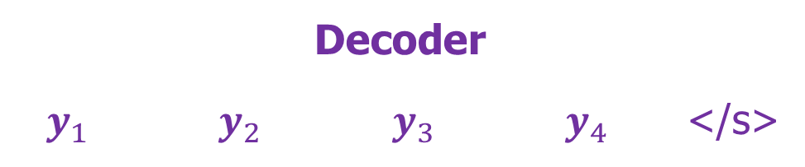

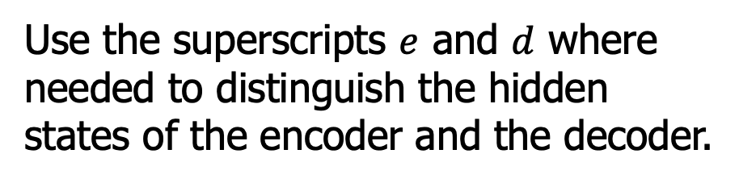
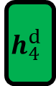
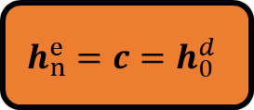
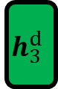
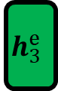
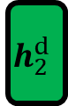
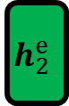


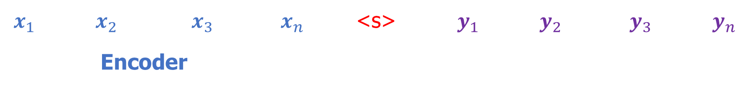
Translating a single sentence
Use the superscripts $e$ and $d$ where needed to distinguish the hidden states of the encoder and the decoder.
Decoder
$y_{1}$ $y_{2}$ $y_{3}$ $y_{4}$ </s>
Softmax
(output of source is ignored during encoding)
Hidden layer(s)
$$h_{1}^{e}$$
$$h_{2}^{e}$$
$$h_{3}^{e}$$
$$h_{n}^{e}=c=h_{0}^{d}$$
$$h_{1}^{d}$$
$$h_{2}^{d}$$
$$h_{3}^{d}$$
$$h_{4}^{d}$$
$$h_{n}^{d}$$
Embedding
$x_{1}$ $x_{2}$ $x_{3}$ $x_{n}$ <s> $y_{1}$ $y_{2}$ $y_{3}$ $y_{n}$
Encoder
Notes:
编码器的全部目的是生成输入的上下文表示。 这种表示体现在编码器的最终隐藏状态 h 中。 这个表示，也称为上下文的 c，然后被传递给解码器。
右侧的解码器网络采用此状态并使用它来初始化解码器的第一个隐藏状态。 也就是说，第一个解码器 RNN 单元使用 c 作为其先前的隐藏状态 h。 解码器自回归生成一系列输出，一个
一个元素，直到生成序列结束标记。 每个隐藏状态都以前一个隐藏状态和前一个状态生成的输出为条件。

Slide 43
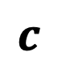
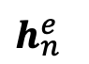
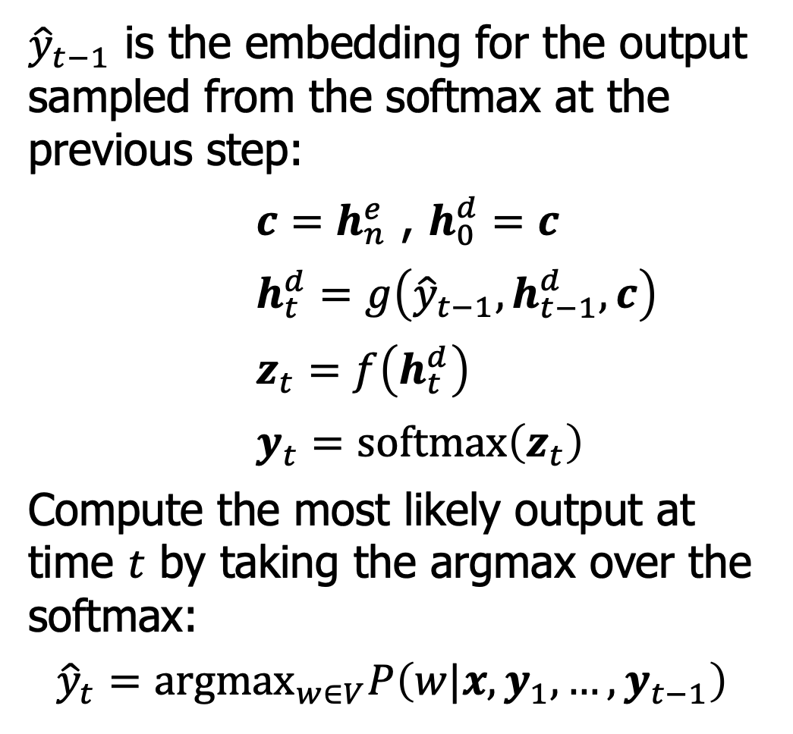
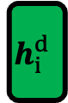
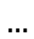
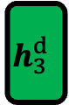
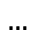
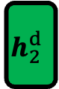
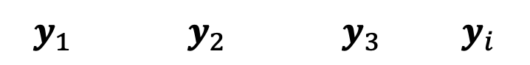
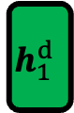
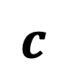
Translating a single sentence
${\hat{y}}_{t−1}$ is the embedding for the output sampled from the softmax at the previous step:
$c=h_{n}^{e}$ , $h_{0}^{d}=c$
$h_{t}^{d}=g\left({\hat{y}}_{t−1},h_{t−1}^{d},c\right)$
$z_{t}=f\left(h_{t}^{d}\right)$
$y_{t}=softmax\left(z_{t}\right)$
Compute the most likely output at time $t$ by taking the argmax over the softmax:
$${\hat{y}}_{t}={argmax}_{w∈V}P\left(w|x,y_{1},…,y_{t−1}\right)$$
$y_{1}$ $y_{2}$ $y_{3}$ $y_{i}$
$$h_{1}^{d}$$
$$h_{2}^{d}$$
$$h_{3}^{d}$$
$$h_{i}^{d}$$
$$…$$
$h_{n}^{e}$
$$…$$
$$c$$
$$c$$
$$c$$
$$c$$

Slide 44
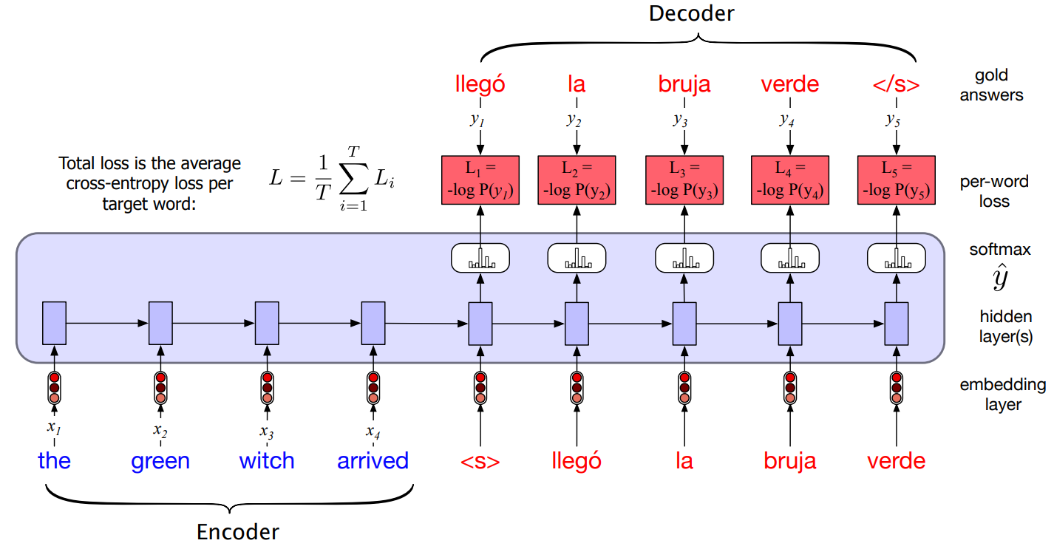
Training the Encoder-Decoder Model
Concatenated with a separator token, these source-target pairs can serve as training data. The network is given source text and then starting with the separator token is trained autoregressively to predict the next word.
Notes:
与分隔符连接后，这些源-目标对现在可以用作训练数据。
网络获得源文本，然后从分隔符开始进行自回归训练以预测下一个单词。

Slide 45
Outline
Introduction
Methods
Word-Based Models & Phrase-Based Models
Encoder-Decoder Models
Encoder-Decoder with RNNs
Attention-based
Decoding
Evaluation
Notes:
针对机器翻译任务，如何对模型进行评估机是一个非常值得讨论的话题，如果你找到一群机器翻译研究人员并互相交谈，你会注意到他们最后都会谈论模型的评估。翻译评估问题很难，甚至难道不可能有效评估。

Slide 46
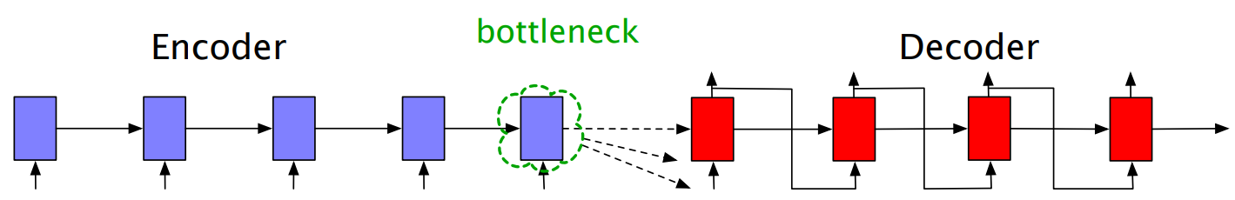
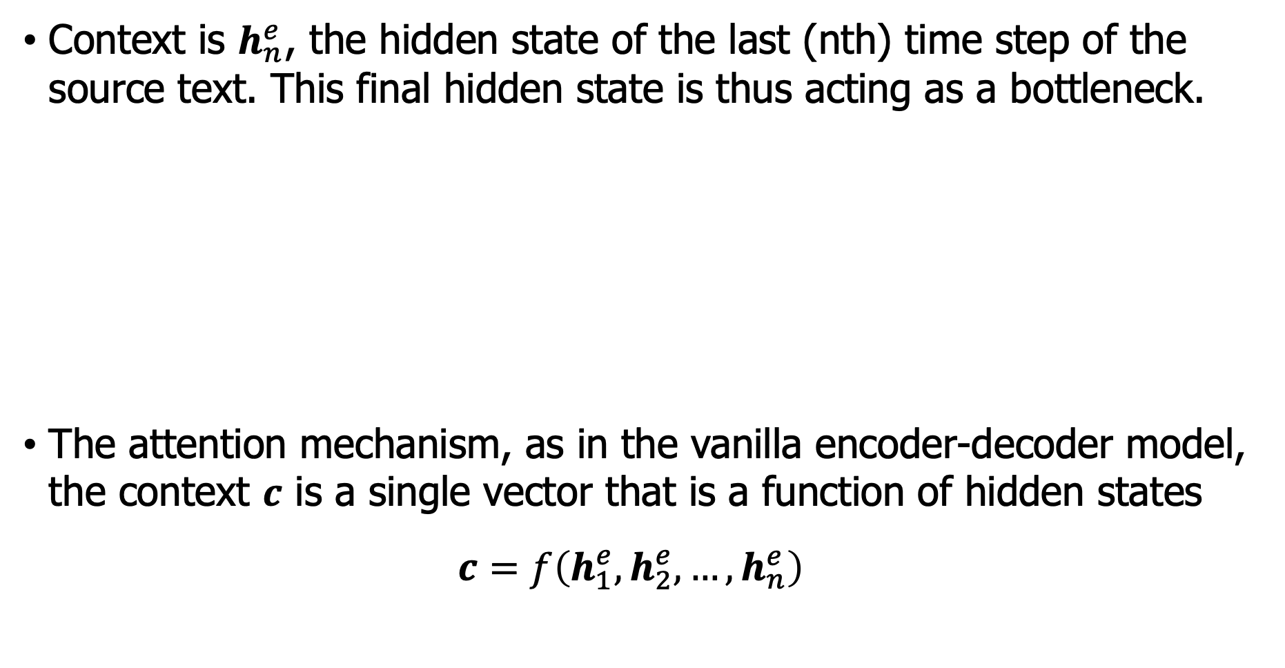
Bottleneck of RNNs
Context is $h_{n}^{e}$, the hidden state of the last (nth) time step of the source text. This final hidden state is thus acting as a bottleneck.
The attention mechanism, as in the vanilla encoder-decoder model, the context $c$ is a single vector that is a function of hidden states
$$c=f\left(h_{1}^{e},h_{2}^{e},…, h_{n}^{e}\right)$$
Notes:
编码器-解码器模型的简单性在于它将编码器（构建源文本的表示）与解码器清晰地分离，解码器使用此上下文生成目标文本。 在我们迄今为止描述的模型中，这个上下文向量是 hn，即源文本的最后（第 n 个）时间步的隐藏状态。 因此，这个最终的隐藏状态充当了一个瓶颈：它必须绝对代表关于源文本含义的所有内容，因为解码器对源文本的唯一了解就是这个上下文向量中的内容
注意机制，就像在普通的编码器-解码器模型中一样，上下文向量 c 是单个向量，它是编码器隐藏状态的函数

Slide 47
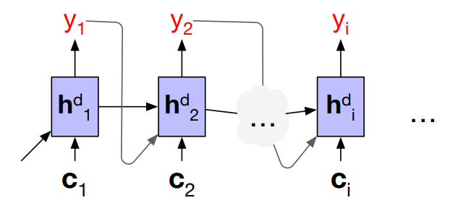

Context vector $c$
$c=f\left(h_{1}^{e},h_{2}^{e},…, h_{n}^{e}\right)$ single context vector is a bad idea:
The number of hidden states varies with the size of the input, we can’t use the entire encoder hidden state vectors directly as the context for the decoder.
Create the single fixed-length vector $c$
Attention: Take a weighted sum of all the encoder hidden states
How to calculate $c_{i}$?
Notes:
隐藏状态的数量随着输入的大小而变化，我们不能直接使用整个编码器隐藏状态向量作为解码器的上下文。

Slide 48

Context vector $c_{i}$
$c_{i}$is to compute how much to focus on each encoder state, how relevant each encoder state is to the decoder state captured in $h_{i−1}^{d}$
capture relevance by computing a score $score\left(h_{i−1}^{d},h_{j}^{e}\right)$
Simplest score, dot-product attention:
$$score\left(h_{i−1}^{d},h_{j}^{e}\right)=h_{i−1}^{d}⋅h_{j}^{e}$$
reflects the degree of similarity between the two vectors.
Other scores: $score\left(h_{i−1}^{d},h_{j}^{e}\right)=h_{i−1}^{d}W_{s}h_{j}^{e}$
normalize them with a softmax to create a vector of weights $α_{ij}$

Slide 49

Context vector $c_{i}$
$α_{ij}$: the proportional relevance of each encoder hidden state $h_{j}^{e}$ to the prior hidden decoder state $h_{i−1}^{d}$
$$α_{ij}=softmax\left(score(h_{i−1}^{d},h_{j}^{e})\right) ∀j∈e$$
$$α_{ij}=\frac{\exp\left(score\left(h_{i−1}^{d},h_{j}^{e}\right)\right)}{\sum_{k}{\exp\left(score\left(h_{i−1}^{d},h_{k}^{e}\right)\right)}}$$
Fixed-length context vector for the current decoder state by taking a weighted average over all the encoder hidden states
$$c_{i}=\sum_{j}{α_{ij}h_{j}^{e}}$$

Slide 50

Encoder-decoder with attention

Slide 51



Encoder-Decoder with Transformers
Encoder contains $N$(e.g. $=6$) stacked Transformer blocks. It outputs a cross-attention.
Decoder has an extra cross-attention layer. Queries as usual come from the previous layer of the decoder.
But the keys and values come from the output of the encoder.
Inputs: $X=\left[x_{1},x_{2},…,x_{T}\right]$
Hidden $H^{enc}=h_{1}h_{2},…h_{T}$
Notes:
图示：编码器-解码器架构使用Transformer 组件。 编码器使用我们在第 9 章中看到的Transformer模块，而解码器使用更强大的块，带有额外的编码器-解码器注意力层。 编码器 H 的最终输出用于形成每个解码器块中交叉注意力层的 K 和 V 输入。

Slide 52
Outline
Introduction
Methods
Word-Based Models & Phrase-Based Models
Encoder-Decoder Models
Encoder-Decoder with RNNs
Attention-based
Decoding: Beam Search
Evaluation
Notes:
针对机器翻译任务，如何对模型进行评估机是一个非常值得讨论的话题，如果你找到一群机器翻译研究人员并互相交谈，你会注意到他们最后都会谈论模型的评估。翻译评估问题很难，甚至难道不可能有效评估。

Slide 53


Decoding
At each time step $t$ in decoding the output $y_{t}$ is chosen by computing a softmax over target vocabulary, and then choosing the highest probability token:
$${\hat{y}}_{t}=\arg{\max_{w∈V}{P\left(w|x,y_{1},…,y_{t−1}\right)}}$$
It is actually a greedy method!
Example, $V=\left\{ok,yes,\text{</}\text{s}\text{> }\right\}$.
Nodes: words
Edges: conditional probabilities
Translation of the greedy method: ?
The optimal method: ?
Notes:
这实际上是贪心算法：在每个步骤中，选择最可能生成的那个token。然而，贪心算法是一种做出局部最优选择的算法，并不一定能够保证全局最优，所以导致生成的翻译不是概率最高的那个句子。
本质上，这个问题是一个图上的搜索过程可以看成是广度优先搜索。
让我们通过查看搜索树来了解这一点，它是解码器在搜索最佳翻译时所做选择的图形表示，其中我们将解码问题视为启发式状态空间搜索并系统地探索可能输出的空间。 在这样的搜索树中，分支是动作，在这种情况下，是生成token的动作，节点是状态，在这种情况下，是生成特定前缀的状态。 我们正在寻找最佳动作序列，即概率最高的目标字符串。
图：词汇表 V = {yes,ok,<s>} 生成目标字符串 T 的搜索树，给定源字符串，显示从该状态生成每个标记的概率。 贪婪搜索会在第一个时间步选择是，然后是是，而不是全局最可能的序列 ok ok。

Slide 54


Decoding - Beam Search
Beam search: Instead of choosing the best token to generate at each timestep, we keep $k$ possible tokens at each step. $k$ is the beam width.
Beam search is still a greedy method, but it is better than pure greedy search.
Google NMT model: “We use beam search during decoding to find the sequence $Y$ that maximizes a score function $s(Y, X)$ given a trained model…”
Notes:
MT序列生成问题中的解码通常使用一种称为波束搜索的方法。 在波束搜索中，我们不是在每个时间步选择最好的令牌生成，而是在每个步骤保留 k 个可能的令牌。 这个固定大小的内存占用 k 称为光束宽度，比喻手电筒光束可以参数化为更宽或更窄
在计算机科学中，光束搜索是一种启发式搜索算法，它通过在有限集合中扩展最有希望的节点来探索图。 束搜索是对最佳优先搜索的优化，可降低其内存需求。 最佳优先搜索是一种图搜索，它根据一些启发式方法对所有部分解决方案（状态）进行排序。 但是在束搜索中，只有预定数量的最佳部分解被保留为候选。

Slide 55


Decoding - Beam Search
Beam search:
First step: compute a softmax over the entire vocabulary, assigning a probability to each word.
Select the $k$-best options from this softmax output. These initial $k$ outputs are the search frontier and these $k$ initial words are called hypotheses.
Example: beam width $k=2$
EOS: The end of source text
Notes:
光束搜索解码，光束宽度为 k = 2的一个例子。在每个时间步，我们选择 k 个最佳Softmax输出的单词，计算每个被选中的单词可进一步扩展，得到 2 ∗ V 个可能假设进行评分，并选择最佳 k 继续。
EOS: End of source
在时间 t1，边界被解码器初始状态的最佳 2 个选项填充：arrived 和 the。 然后我们对每一个单词进一步扩展，并计算到目前为止所有假设的概率（arrived the, arrived aardvark, the green, the witch）并计算最好的解码序列，作为时间t2的输出，在本例中为the green 和the witch 作为搜索前提，延伸到下一步。

Slide 56


Decoding - Beam Search
Scoring: each node scores by its log probability $score\left(y\right)=\log{p\left(y | x\right)}$. Use chain rule, at time $t$,
$$score\left(y_{t}\right)=\sum_{i=1}^{t}{\log{p\left(y_{i} | y_{1}y_{2},…,y_{i−1},x\right)}}$$
Notes:
那么每一步的分值是如何计算的？
因此，在每一步，为了计算部分翻译的概率，我们只需将到目前为止前缀翻译的对数概率添加到生成下一个标记的对数概率中。
使用 k = 2 的波束宽度对波束搜索解码进行评分。我们通过递增地添加生成每个下一个令牌的对数概率来保持波束中每个假设的对数概率。 只有前 k 个路径被扩展到下一步。

Slide 57

Decoding - Beam Search
Scoring: $\sum_{i=1}^{t}{\log{p\left(y_{i} | y_{1}y_{2},…,y_{i−1},x\right)}}$, it is biased towards to short translations.
Reason: models generally assign lower probabilities to longer strings, a naive algorithm would also choose shorter strings for $y$.
Strategy: apply some form of length normalization to each of the hypotheses.
Example solution:
$$score\left(y\right)=−\log{p\left(y | x\right)}=\frac{1}{T}\sum_{i=1}^{T}{−\log{p\left(y_{i}|y_{1},…,y_{i−1},x\right)}}$$

Slide 58


Decoding - Practice
Real-world NMT systems usually set $k$ in the range [5,10]
NMT usually contains multiple translation options
Option 1
Option 2

Slide 59

OOV Problems
Two type of approaches to address out-of-vocabulary (OOV) words.
simply copy rare words from source to target
use sub-word units, e.g., characters, mixed words/characters.
Wordpiece: use a special symbol at the beginning of each token
Words: Jet makers feud over seat width with big orders at stake
Word pieces: _J et _makers _fe ud _over _seat _width _with _big _orders _at _stake
Notes:
一种方法是简单地将稀有词从源复制到目标（因为大多数稀有词是名称或数字，正确的翻译只是副本）
通常，源语言和目标语言使用共享词汇表，这使得将标记（如名称）从源语言复制到目标语言变得容易，因此我们在包含源语言和目标语言数据的语料库上构建 wordpiece/BPE 词典。
构建词片集合：用字符初始化词片词典（例如，Unicode 字符的子集，将所有剩余的字符折叠为特殊的未知字符标记）。重复直到有 V 个 wordpieces：在训练语料库上训练一个 n-gram 语言模型，使用当前词条集。
考虑通过连接当前词典中的两个词片而产生的一组可能的新词片。 选择最能增加训练语料的语言模型概率的一个新词。
通常使用 8K 到 32K 词块的词汇表。

Slide 60
Outline
Introduction
Methods
Word-Based Models & Phrase-Based Models
Encoder-Decoder Models
Encoder-Decoder with RNNs
Attention-based
Decoding: Beam Search
Training Data
Evaluation
Notes:
针对机器翻译任务，如何对模型进行评估机是一个非常值得讨论的话题，如果你找到一群机器翻译研究人员并互相交谈，你会注意到他们最后都会谈论模型的评估。翻译评估问题很难，甚至难道不可能有效评估。

Slide 61
Training corpora
Machine translation models are trained on a parallel corpus, or called a bitext. Example corpus:
Europarl Corpus: extracted from the proceedings of the European Parliament, contains between 400,000 and 2 million sentences each from 21 European languages. (Philipp Koehn, MT Summit 2005, https://www.statmt.org/europarl/)
United Nations Parallel Corpus: contains on the order of 10 million sentences in the six official languages of the United Nations (Arabic, Chinese, English, French, Russian, Spanish). (Ziemski et al. 2016, https://conferences.unite.un.org/uncorpus)
OpenSubtitles: parallel corpora have been made from movie and TV subtitles. (Lison and Tiedemann, 2016, http://www.opensubtitles.org/)
ParaCrawl: corpus of 223 million sentence pairs between 23 EU and English extracted from CommonCrawl (Banon et al. 2020, https://paracrawl.eu/index.php)
Notes:
Europarl 语料库是一个语料库（一组文件），由 1996 年至 2012 年的欧洲议会会议记录组成。在 2001 年首次发布时，它涵盖了欧盟的 11 种官方语言（丹麦语、荷兰语、英语、芬兰语、 法语、德语、希腊语、意大利语、葡萄牙语、西班牙语和瑞典语）。
联合国平行语料库：包含联合国六种官方语言（阿拉伯文、中文、英文、法文、俄文、西班牙文）的大约 1000 万个句子。 （Ziemski 等人，2016）

Slide 62

Creating training corpora - alignment
Creating a new corpora, sentence alignments must be created. Two steps:
a cost function: takes a span of source sentences and a span of target sentences and returns a score measuring how likely these spans are to be translations.
an alignment algorithm that takes these scores to find a good alignment between the documents.
Many ways:
Minimum edit distance
Corpus cleanup
Handwritten rules
Ranking
Notes:
最后，通过删除噪音noisy的句子对来做一些语料库清理是有帮助的。 这可能涉及删除低精度对的手写规则（例如删除太长、太短、具有不同 URL 的句子，甚至是太相似的对，表明它们是复制而不是翻译）。 或者对可以通过它们的多语言嵌入余弦分数和丢弃的低分数对进行排名。

Slide 63
Creating training corpora - backtranslation
Short of data for training MT models
Backtranslation: A way of making use of monolingual corpora in the target language by creating synthetic bitexts
Example: we want to translate from Navajo to English but only have a small Navajo-English bitext
use the small bitext to build an MT engine from English to Navajo
translate the monolingual English text to Navajo (Monte Carlo decoding)
add these synthetic English-Navajo bitext to our training data
Backtranslation works surprisingly well (Edunov et al., 2018)
Notes:
我们经常缺乏训练 MT 模型的数据，因为并行语料库可能仅限于特定语言或领域。 但是，我们通常可以找到一个大型的单语语料库，以添加到可用的较小的并行语料库中。
美洲原住民的纳瓦霍人纳瓦霍语，17万人使用。例如，假设我们想从纳瓦霍语翻译成英语，但只有少量的纳瓦霍语-英语双文本，当然我们可以找到很多单语英语数据。 我们使用小比特文本来构建一个相反的机器翻译引擎（从英语到纳瓦霍语）
反向翻译是一种通过创建合成双文本来利用目标语言中的单语语料库的方法。 在反向翻译中，我们在小型双文本上训练一个中间目标到源 MT 系统来翻译单语目标
数据到源语言。 现在我们可以将这个合成的双文本（自然目标句子，与 MT 生成的源句子对齐）添加到我们的训练数据中，并重新训练我们的源到目标 MT 模型。 例如假设我们要翻译
从纳瓦霍语到英语，但只有少量的纳瓦霍语-英语双语，当然我们可以找到很多单语英语数据。 我们使用小的 bittext 来构建一个以另一种方式（从英语到纳瓦霍语）的 MT 引擎。 一旦我们将单语英语文本翻译成纳瓦霍语，我们就可以将这个合成的纳瓦霍语/英语双语文本添加到我们的训练数据中。

Slide 64
Outline
Introduction
Methods
Word-Based Models & Phrase-Based Models
Encoder-Decoder Models
Evaluation
Notes:
针对机器翻译任务，如何对模型进行评估机是一个非常值得讨论的话题，如果你找到一群机器翻译研究人员并互相交谈，你会注意到他们最后都会谈论模型的评估。翻译评估问题很难，甚至难道不可能有效评估。

Slide 65
Evaluate MT model is hard
All automatic machine translation evaluation metrics in practical use for guiding research are based on the comparison of the system output to a gold standard reference translation.
Two challenges:
The ambiguity of the translation: Since even two professional translators will almost always produce two different translations for the same sentence, perfectly matching a single human reference translation is too high a bar to reach for machine translation.
Matching words and word order: We not only have to deal with matching words but also with word order. Some word order differences are legitimate, some are not.
Notes:
实际用于指导研究的所有自动机器翻译评估指标都是基于系统输出与标准参考翻译reference的比较。
1. 翻译的模棱两可：由于即使是两位专业翻译人员也几乎总是会为同一个句子产生两种不同的翻译，因此完美匹配单个人工参考翻译对于机器翻译来说难度太大了。
2. 我们不仅要处理匹配词，还要处理词序。 有些词序差异是合法的，有些则不是。

Slide 66
Evaluation
Evaluated along two dimensions: adequacy and fluency
Adequacy: Does the output convey the same meaning as the input sentence?
Is part of the message lost, added, or distorted?
Fluency: Is the output good fluent English? This involves both grammatical correctness and idiomatic word choices.
Evaluation metrics
1) subjective judgments by human evaluators
2) automatic evaluation metrics
3) task-based evaluation, e.g. how much post-editing effort?
Hard problem, since many different translations acceptable
semantic equivalence / similarity
Notes:
给我一个机器翻译系统或者模型，我们怎么评估它的好坏呢？
充分性：我们翻译的句子对源句准确含义的把握程度，也就是翻译有多忠实于原文。
流畅度：翻译在目标语言中的流畅程度（语法、清晰、可读、自然）。
评估指标包括：1）人类评价者的主观判断，使用人工评估是最准确的；人类判断, 给定机器翻译输出源和/或参考翻译，任务是评估机器翻译输出的质量；2）但为了方便，自动评估指标，也使用自动计算的指标BLEU。3）基于任务的评判方法：里面比如多少人工时间进行后期编辑工作？
整体上，翻译的评估是一个难题，NP-hard问题。语义等价的特点导致的。

Slide 67
Goals for Evaluation Metrics
Low cost: reduce time and money spent on carrying out evaluation
Tunable: automatically optimize system performance towards metric
Meaningful: score should give intuitive interpretation of translation quality
Consistent: repeated use of metric should give same results
Correct: metric must rank better systems higher

Slide 68
Other Evaluation Criteria
When deploying systems, considerations go beyond quality of translations
Speed: we prefer faster machine translation systems
Size: fits into memory of available machines (e.g., handheld devices)
Integration: can be integrated into existing workflow
Customization: can be adapted to user’s needs

Slide 69
Problem: No Single Right Answer
(A typical example from the 2001 NIST evaluation set )
Chinese Input
这个机场的安全工作由以色列方面负责。
English Translation
Israeli officials are responsible for airport security.
Israel is in charge of the security at this airport.
The security work for this airport is the responsibility of the Israel government.
Israeli side was in charge of the security of this airport.
Israel is responsible for the airport’s security.
Israel is responsible for safety work at this airport.
Israel presides over the security of the airport.
Israel took charge of the airport security.
The safety of this airport is taken charge of by Israel.
This airport’s security is the responsibility of the Israeli security officials.
Notes:
机器翻译的一大问题。这实际上不是一个完美定义的任务。没有一个正确的答案。这是来自多个翻译中文文本的实际语料库的实际数据。这是大约 20 年前准备的，当时最大的挑战是我们能否用统计方法将中文翻译成英文并检查翻译的质量。让我们与人工翻译进行比较，而不是只取一个人工翻译，取多个人工翻译，所以所有的句子都由 10 个不同的翻译机构翻译，他们提出了这些不同的翻译，如果你通读这些句子，发现它们的意思几乎是一样的。任何人这些翻译中的任何一个都可能会受到批评，你们中的一些人可能更喜欢其他一些翻译这在翻译中很有名，他们从不真正喜欢其他人的翻译和其他人的翻译，所以在这个论点中什么是正确的，如果你真的把它钉牢了，你甚至可以声称所有这些都是错误的，那个中文标题有某种细微差别。在翻译过程中总是会迷路，但令人惊讶的是，这 10 家不同的翻译机构提出了 10 种不同的翻译，这并不罕见，这是标准的任何合理长度的句子，甚至根本不是一个长句子。如果你把它给两个不同的翻译，他们会想出两个不同的翻译。

Slide 70
Outline
Introduction
Methods
Word-Based Models & Phrase-Based Models
Encoder-Decoder Models
Evaluation
Human raters
Notes:
针对机器翻译任务，如何对模型进行评估机是一个非常值得讨论的话题，如果你找到一群机器翻译研究人员并互相交谈，你会注意到他们最后都会谈论模型的评估。翻译评估问题很难，甚至难道不可能有效评估。

Slide 71
Human Raters
Along the dimension of fluency, we can ask how intelligible, how clear, how readable, or how natural the MT output (the target text) is.
Give the raters a scale, for example, from 1 (totally unintelligible) to 5 (totally intelligible, or 1 to 100, and ask them to rate each sentence or paragraph.
Along the dimension of adequacy, using raters to assign scores on a scale. If we have bilingual raters, we can give them the source sentence and a proposed target sentence, and rate, on a 5-point or 100-point scale, how much of the information in the source was preserved in the target.
Ranking: give a pair of candidate translations, ask raters which one they prefer
Notes:
最准确的评估使用人工评估者（例如在线众包工作者）来评估两个维度上的每个翻译。 例如，沿着流畅度的维度，我们可以问机器翻译出的句子的可理解程度、清晰程度、可读性或自然程度。
给评分者一个等级，例如，从 1（完全无法理解）到 5（完全可以理解，或 1 到 100），并要求他们对每个句子或段落进行评分。
沿着充分性维度，使用评分者按比例分配分数。
如果我们有双语评分者，我们可以给他们源句和建议的目标句，并以 5 分或 100 分的等级对源语句中保留了多少信息在目标中。
如果我们只有单语评估者，但我们对源文本有良好的人工翻译，我们可以为单语评估者提供人工参考翻译和目标机器。翻译并再次评估保留了多少信息。
另一种方法是排名做排名：给评估者一对候选翻译，并询问他们更喜欢哪一个。

Slide 72
Evaluation - Human Assessments
Side-by-side evaluations: Given a source sentence, human raters evaluate and compare the quality of two translations presented side by side.
Side-by-side scores range from 0 to 6
0: the translation is completely nonsense
2: the translation preserves some of the meaning of the source sentence but misses significant parts
4: the translation retains most of the meaning of the source sentence, but may have some grammar mistakes
6: the translation is completely consistent with the source sentence, and the grammar is correct
Wu Y, Schuster M, Chen Z, Le QV, Norouzi M, Macherey W, Krikun M, Cao Y, Gao Q, Macherey K, Klingner J. Google's neural machine translation system: Bridging the gap between human and machine translation. arXiv preprint arXiv:1609.08144. 2016 Sep 26.
Notes:
有些时候BLEU 并不能够捕获翻译质量的所有。这个时候就应该让人工翻译专家来帮忙。
These scores are generated by human raters who are fluent in both languages and hence often capture translation quality better than BLEU scores.

Slide 73
Human Raters - Evaluators Disagree
Histogram of adequacy judgments by different human evaluators
(from WMT 2006 evaluation)
Notes:
对人类评估者（通常是在线众包工作者）进行培训是必不可少的； 没有翻译专业知识的评估者很难区分流畅性和充分性，因此培训包括仔细区分这些的示例。 评分者评分的差异很大（源句可能模棱两可，评估者有不同的背景知识，评估者可能会以不同的程度打分）。 因此，通常评分者离平均值远的那些删除，如果我们使用足够细粒度的尺度，也可以通过从评分中减去平均值并除以方差来对评分者进行归一化。

Slide 74


Measuring Agreement between Evaluators
Kappa coefficient (for inter-rater reliability)
$K=\frac{p\left(A\right)−p\left(E\right)}{1−p\left(E\right)}$
$p\left(A\right)$: proportion of times that the evaluators agree
$p\left(E\right)$: proportion of times that they would agree by chance (5-point scale, $p\left(E\right)=1/5$)
Example: Inter-evaluator agreement in WMT 2007 evaluation campaign
Value of Kappa | Level of Agreement | % of Data that are Reliable
0–.20 | None | 0–4%
.21–.39 | Minimal | 4–15%
.40–.59 | Weak | 15–35%
.60–.79 | Moderate | 35–63%
.80–.90 | Strong | 64–81%
Above .90 | Almost Perfect | 82–100%
Evaluation Type | $$p\left(A\right)$$ | $$p\left(E\right)$$ | $$K$$
Fluency | .400 | .2 | .250
Adequacy | .380 | .2 | .226
Notes:
当我们考虑评估时，这绝对是非常值得考虑的事情，这是设计评估指标的关键目标之一：
应用相同标准的不同评估者之间存在多少分歧，判断中有多少分歧。这显然是从统计角度来看，我们看看这些评估人员的整体是稳定还是变化很大。
这里面，我们使用Kappa 一个Kappa 系数。P(A): 评估者同意的次数比例; p(E): 他们偶然同意的次数比例, 这个是对于分类数据是比较合理有用的。
Cohen 的 kappa 系数 (κ) 是用于衡量分类数据的评分者间可靠性（以及评分者内可靠性）的统计量。

Slide 75


Ranking Translations
Task for evaluator: Is translation $X$ better than translation $Y$?
choices: better, worse, equal
Evaluators are more consistent:
Evaluation Type | $$p\left(A\right)$$ | $$p\left(E\right)$$ | $$K$$
Fluency | .400 | .2 | .250
Adequacy | .380 | .2 | .226
Sentence ranking | .582 | .333 | .373
Notes:
一共9种，相等可能的有3种。

Slide 76
Outline
Introduction
Methods
Word-Based Models & Phrase-Based Models
Encoder-Decoder Models
Evaluation
Human raters
Precision, Recall
Notes:
针对机器翻译任务，如何对模型进行评估机是一个非常值得讨论的话题，如果你找到一群机器翻译研究人员并互相交谈，你会注意到他们最后都会谈论模型的评估。翻译评估问题很难，甚至难道不可能有效评估。

Slide 77

Precision and Recall of Words
System A: Israeli officials responsibility of airport safety
REFERENCE: Israeli officials are responsible for airport security
Matching of System A: Israeli officials responsibility of airport safety
Precision
$$Pre=\frac{correct}{output_length}=\frac{3}{6}=50\%$$
Recall
$$Rec=\frac{correct}{reference_length}=\frac{3}{7}≈43\%$$
F-measure
$$F1=\frac{2⋅Pre⋅Rec}{Pre+Rec}≈46\%$$

Slide 78
Precision and Recall of Words
System A: Israeli officials responsibility of airport safety
System B: airport security Israeli officials are responsible
REFERENCE: Israeli officials are responsible for airport security
Matching of System A: Israeli officials responsibility of airport safety
Matching of System B: airport security Israeli officials are responsible
Metric | System A | System B
Precision | 50% | 100%
Recall | 43% | 100%
F-measure | 46% | 100%
Flaw: no penalty for reordering

Slide 79

Character F-score - chrF
A good machine translation will tend to contain characters and words that occur in a human translation of the same sentence.
Test set: each source sentence has both a gold human target translation and a candidate MT translation we’d like to evaluate.
$$chrF_{β}=\left(1+β^{2}\right)⋅\frac{chrP⋅chrR}{β^{2}⋅chrP+chrR}$$
chrP: percentage of character 1-grams, 2-grams, ..., $k$-grams in the model that occur in the gold, averaged.
chrR: percentage of character 1-grams, 2-grams,..., $k$-grams in the gold that occur in the model, averaged.
Notes:
字符 F-分数值的主要思想是：一个好的机器翻译往往会包含在同一个句子的人工翻译中出现的字符和单词。
在测试集中：每个源句子都有一个人类翻译的正确的标准句子和一个我们想要评估的候选的机器翻译的句子。
chrF 度量通过与人工翻译重叠的字符 n-gram 数量的函数对每个 MT 目标句子进行排序。
chrP: 假设中出现在参考中的字符 1-gram、2-gram、...、𝑘-gram 的百分比，平均。
chrR: 假设中出现的参考中字符 1-gram、2-gram、...、𝑘-gram 的百分比，平均。

Slide 80

Character F-score - Example
Consider two model sentences that against the reference translation
Using parameters ($k=β=2$)
Gold: witness for the past
Result 1: witness of the past
Result 2: past witness
Method: chrF ignores spaces, so remove them
Gold: witnessforthepast, (18 unigrams, 17 bigrams)
Result 1: witnessofthepast, (17 unigrams, 16 bigrams)
Notes:
实际中k的值会相对大一点。

Slide 81
Character F-score - Example
1) unigrams and bigrams match between the reference and hypothesis:
unigrams that match: w i t n e s s f o t h e p a s t , (17 unigrams)
bigrams that match: wi it tn ne es ss th he ep pa as st t, (13 bigrams)
2) compute the unigram and bigram precisions and recalls:
unigram P: 17/17 = 1 unigram R: 17/18 = .944
bigram P: 13/16 = .813 bigram R: 13/17 = .765
3) average to get chrP and chrR, and compute the F-score:
chrP = (17/17+13/16)/2 = .906
chrR = (17/18+13/17)/2 = .855
chrF(2,2)= 5 * chrP∗ chrR / (4*chrP+chrR) = .86
Notes:
chrF 是非常局部的：一个大的短语移动可能几乎不会改变 chrF 分数，并且 chrF 无法评估文档的跨句属性，例如其话语连贯性。
在评估对单个系统的更改时，像 chrF 这样的自动重叠度量是最合适的。

Slide 82
Outline
Introduction
Methods
Word-Based Models & Phrase-Based Models
Encoder-Decoder Models
Evaluation
Human raters
Precision, Recall
BLEU
Notes:
针对机器翻译任务，如何对模型进行评估机是一个非常值得讨论的话题，如果你找到一群机器翻译研究人员并互相交谈，你会注意到他们最后都会谈论模型的评估。翻译评估问题很难，甚至难道不可能有效评估。

Slide 83

BLEU
“BLUE” pronounces it blue. bilingual evaluation understudy
Idea: the closer a machine translation is to a professional human translation, the better it is.
BLEU score does not fully capture the quality of a translation: Although it has significant advantages, there is no guarantee that an increase in BLEU score is an indicator of improved translation quality.
Notes:
Understudy: 双语评估替补/辅助工具，2002年的时候，基本上是人工评价，这里的替补的意思是. 在戏剧界，替补是学习更高级演员的角色的人，因此他们可以在必要时接替最高级编辑的角色
机器翻译结果越接近专业人工翻译的结果，则越好。BLEU算法实际上就是在判断两个句子的相似程度。想知道一个句子翻译前后的表示是否意思一致，直接的办法是拿这个句子的标准人工翻译与机器翻译的结果作比较，如果它们是很相似的，说明我的翻译很成功。

Slide 84

BLEU - motivation
Chinese: 猫在垫子上。
Reference 1: The cat is on the mat. (By translator 1.)
Reference 2: There is a cat on the mat. (By translator 2.)
Idea from precision: counts up the number of candidate translation words which occur in any reference translation and then divides by the total number of words in the candidate translation.
$n$-gram: we not only count words but also count $n$-gram
Notes:
双语评估研究，BLEU。
这两个都是比较好的，正确的翻译。
BLEU score 可以根据你提供的reference 翻译，来计算一个针对机器翻译出的句子的一个指标值。这里的直觉是，只要机器生成的翻译非常接近人类提供的任何参考文献，它就会获得高分。
分子是一个候选翻译的单词有多少出现在参考翻译中，出现过就记一次，不管是不是在同一句参考翻译里头，分母是这个候选翻译的词汇数。
BLEU 分数背后的直觉是我们查看机器生成的输出，看看它生成的单词类型是否出现在至少一个reference生成的参考中，这些人类生成的参考将作为一部分提供 测试集。 现在让我们看一个有点极端的例子，假设机器翻译系统缩写机器翻译是空的，所以机器翻译输出的机器翻译是。
分母：7 个单词
分子：count_clip(“the”)

Slide 85

BLEU
Example 1
Chinese: 猫坐在垫子上
Reference 1: the cat is on the mat
Reference 2: there is a cat on the mat
Candidate: the cat the cat on the mat
Example 2
Chinese: 猫坐在垫子上
Reference 1: the cat is on the mat
Reference 2: there is a cat on the mat
Candidate: the the the the the the the the
Precision: count each of the $n$-gram in the candidate sentence whether it has shown in any of the reference sentences, gather the total counts for each of the unique $n$-gram, sum up the total counts for each of the unique $n$-gram, and divided by the number of $n$-grams in the candidate sentence.
Notes:
计算候选句子中的每个 𝑛-gram 是否出现在任何参考句子中，收集每个唯一 𝑛-gram 的总计数，总结每个唯一 𝑛-gram 的总计数，以及 除以候选句子中 𝑛-gram 的数量。

Slide 86
BLEU – unigram case
Example 1
Chinese: 猫坐在垫子上
Reference 1: the cat is on the mat
Reference 2: there is a cat on the mat
Candidate: the cat the cat on the mat
compute the unigram precision for example 1. All the unigrams in the candidate sentences have shown in the reference sentences.
Unique Unigram | Count
the | 3
cat | 2
on | 1
mat | 1
Candidate Unigram | Shown?
the | 1
cat | 1
the | 1
cat | 1
on | 1
the | 1
mat | 1
The total number of counts for the unique unigrams in the candidate sentence is 7
the total number of unigrams in the candidate sentence is 7.
The unigram precision is 7/7 = 1.0
Notes:
候选句子中唯一 unigram 的总计数为 7
候选句子中的 unigram 总数为 7。
一元精度为 7/7 = 1.0

Slide 87
BLEU – unigram case
Example 2
Chinese: 猫坐在垫子上
Reference 1: the cat is on the mat
Reference 2: there is a cat on the mat
Candidate: the the the the the the the the
compute the unigram precision for example 1. All the unigrams in the candidate sentences have shown in the reference sentences.
Candidate Unigram | Shown?
the | 1
the | 1
the | 1
the | 1
the | 1
the | 1
the | 1
the | 1
Unique Unigram | Count
the | 8
The total number of counts for the unique unigrams in the candidate sentence is 8
the total number of unigrams in the candidate sentence is 8.
The unigram precision is 8/8 = 1.0
Notes:
候选句子中唯一 unigram 的总计数为 7
候选句子中的 unigram 总数为 7。
一元精度为 7/7 = 1.0

Slide 88

Modified BLEU – unigram case
unigram precision is very easy to be over-confident about the quality of the machine translation. To overcome this, clipped count and modified precision were proposed.
For each word, $Count_clip = min⁡(Count,Max_Ref_Count)$, counts the maximum number of times a word occurs in any single reference translation.
Unique Unigram | Count | Clipped Count
the | 3 | 2
cat | 2 | 1
on | 1 | 1
mat | 1 | 1
Example 1
Chinese: 猫坐在垫子上
Reference 1: the cat is on the mat
Reference 2: there is a cat on the mat
Candidate: the cat the cat on the mat
The unigram modified precision is 5/7 = 0.714 for example 1
Notes:
一元精度很容易对机器翻译的质量过于自信。 为了克服这个问题，提出了裁剪计数和修改精度。

Slide 89

Modified BLEU – unigram case
unigram precision is very easy to be over-confident about the quality of the machine translation. To overcome this, clipped count and modified precision were proposed.
For each word, $Count_clip = min⁡(Count,Max_Ref_Count)$, counts the maximum number of times a word occurs in any single reference translation.
Example 2
Chinese: 猫坐在垫子上
Reference 1: the cat is on the mat
Reference 2: there is a cat on the mat
Candidate: the the the the the the the the
Unique Unigram | Count | Clipped Count
the | 8 | 2
The unigram modified precision is 2/8 = 0.25 for example 2
Notes:
一元精度很容易对机器翻译的质量过于自信。 为了克服这个问题，提出了裁剪计数和修改精度。

Slide 90
BLEU – bigram case
Example 1
Chinese: 猫坐在垫子上
Reference 1: the cat is on the mat
Reference 2: there is a cat on the mat
Candidate: the cat the cat on the mat
compute the bigram precision for example 1. All the bigrams in the candidate sentences have shown in the reference sentences.
Unique Bigram | Count
the cat | 2
cat the | 0
cat on | 1
on the | 1
the mat | 1
Candidate Bigram | Shown?
the cat | 1
cat the | 0
the cat | 1
cat on | 1
on the | 1
the mat | 1
The total number of counts for the unique bigrams in the candidate sentence is 6
the total number of bigrams in the candidate sentence is 5.
The bigram precision is 5/6 = 0.833
Notes:
候选句子中唯一 unigram 的总计数为 7
候选句子中的 unigram 总数为 7。
一元精度为 7/7 = 1.0

Slide 91
BLEU – bigram case
Example 2
Chinese: 猫坐在垫子上
Reference 1: the cat is on the mat
Reference 2: there is a cat on the mat
Candidate: the the the the the the the the
compute the bigram precision for example 1. All the bigrams in the candidate sentences have shown in the reference sentences.
Unique Bigram | Count
the the | 0
Candidate Bigram | Shown?
the the | 0
the the | 0
the the | 0
the the | 0
the the | 0
the the | 0
the the | 0
The total number of counts for the unique bigrams in the candidate sentence is 7
the total number of bigrams in the candidate sentence is 0.
The bigram precision is 0/7 = 0.0

Slide 92

Modified BLEU – bigram case
Unigram precision is very easy to be over-confident about the quality of the machine translation. To overcome this, clipped count and modified precision were proposed.
For each word, $Count_clip = min⁡(Count,Max_Ref_Count)$, counts the maximum number of times a word occurs in any single reference translation.
Example 1
Chinese: 猫坐在垫子上
Reference 1: the cat is on the mat
Reference 2: there is a cat on the mat
Candidate: the cat the cat on the mat
Unique Bigram | Count | Clipped Count
the cat | 2 | 1
cat the | 0 | 0
cat on | 1 | 1
on the | 1 | 1
the mat | 1 | 1
The bigram modified precision is 4/6 = 0.667 for example 1
Notes:
一元精度很容易对机器翻译的质量过于自信。 为了克服这个问题，提出了裁剪计数和修改精度。

Slide 93

Modified BLEU – bigram case
Unigram precision is very easy to be over-confident about the quality of the machine translation. To overcome this, clipped count and modified precision were proposed.
For each word, $Count_clip = min⁡(Count,Max_Ref_Count)$, counts the maximum number of times a word occurs in any single reference translation.
Unique Bigram | Count | Clipped Count
the the | 0 | 0
Example 2
Chinese: 猫坐在垫子上
Reference 1: the cat is on the mat
Reference 2: there is a cat on the mat
Candidate: the the the the the the the the
The bigram modified precision is 0/7 = 0.0 for example 2
Notes:
一元精度很容易对机器翻译的质量过于自信。 为了克服这个问题，提出了裁剪计数和修改精度。

Slide 94

Practical BLEU
Computed using a couple of $n$-gram modified precisions
$$BLEU=BP⋅\exp\left(\sum_{n=1}^{N}{w_{n}\log{p_{n}}}\right)$$
$N$: the total gram used (e.g., 4)
$p_{n}$: is the modified precision for $n$-gram
$w_{n}$ weights for $\log{p_{n}}$ and $\sum{w_{n}}=1$ (e.g., 1/N)
$BP$: brevity penalty to penalize short machine translations
$$BP=\left\{\begin{aligned}1 if c>r \\ \exp\left(1−\frac{r}{c}\right) if c≤r\end{aligned}\right.$$
$c$ is the number of unigrams (length) in all the candidate sentences, and $r$ is the best match lengths for each candidate sentence in the corpus.
Notes:
惩罚短机器翻译的简洁惩罚。

Slide 95
Outline
Introduction
Methods
Word-Based Models & Phrase-Based Models
Encoder-Decoder Models
Evaluation
Human raters
Precision, Recall
BLEU
WER & Embedding-based
Notes:
针对机器翻译任务，如何对模型进行评估机是一个非常值得讨论的话题，如果你找到一群机器翻译研究人员并互相交谈，你会注意到他们最后都会谈论模型的评估。翻译评估问题很难，甚至难道不可能有效评估。

Slide 96

Word Error Rate (WER)
Minimum number of editing steps to transform output to reference
match: words match, no cost
substitution: replace one word with another
insertion: add word
deletion: drop word
Levenshtein distance
$$WER=\frac{substitutions + insertions + deletions}{reference_length}$$

Slide 97
WER -Example
Metric | System A | System B
Word error rate (WER) | 57% | 71%
Israeli
officials
responsibility
of
airport
safety
airport
security
Israeli
officials
are
responsible
0 | 1 | 2 | 3 | 4 | 5 | 6
1 | 0 | 1 | 2 | 3 | 4 | 5
2 | 1 | 0 | 1 | 2 | 3 | 4
3 | 2 | 1 | 1 | 2 | 3 | 4
4 | 3 | 2 | 2 | 2 | 3 | 4
5 | 4 | 3 | 3 | 3 | 3 | 4
6 | 5 | 4 | 4 | 4 | 3 | 4
7 | 6 | 5 | 5 | 5 | 4 | 4
0 | 1 | 2 | 3 | 4 | 5 | 6
1 | 1 | 2 | 2 | 3 | 4 | 5
2 | 2 | 2 | 3 | 2 | 3 | 4
3 | 3 | 3 | 3 | 3 | 2 | 3
4 | 4 | 2 | 4 | 4 | 3 | 2
5 | 5 | 3 | 5 | 5 | 4 | 3
6 | 5 | 4 | 6 | 6 | 5 | 4
7 | 6 | 5 | 6 | 7 | 6 | 5
Israeli
officials
are
responsible
for
airport
security
Israeli
officials
are
responsible
for
airport
security

Slide 98


Embedding-based Methods
chrF criterion is overly strict, since a good translation may use alternate words or paraphrases.
Idea: allow synonyms to match between reference $x$and candidate $\tilde{x}$.
Consider tuples: $\left(x,\tilde{x}\right)$ where $x=\left(x_{1},x_{2},…,x_{n}\right)$ is a reference translation, $\tilde{x}=({\tilde{x}}_{1},{\tilde{x}}_{2},…,{\tilde{x}}_{m})$ is a candidate machine translation.
BERT-SCORE algorithm:
computing a BERT embedding for each token $x_{i}$ and ${\tilde{x}}_{j}$. Each pair of tokens $\left(x_{i},{\tilde{x}}_{j}\right)$ is scored by its cosine similarity.
Calculate Precision and Recall
Notes:
字符F-值是基于测量人类参考和候选机器翻译所共有的确切字符 n-gram。 chrF 这个标准过于严格，因为好的翻译可能会使用替代词或释义。
主要思想：是允许同义词在参考句子x 和候选句子x 之间匹配。 最近的指标使用 BERT 或其他嵌入来实现这种直觉

Slide 99



Embedding-based Methods
BERT-SCORE provides precision, recall, and F-score
$$R_{BERT}=\frac{1}{|x|}\sum_{x_{i}∈x}{\max_{{\hat{x}}_{j}∈\hat{x}}{x_{i}^{⊤}}} {\hat{x}}_{j} P_{BERT}=\frac{1}{|\hat{x}|}\sum_{{\hat{x}}_{j}∈\hat{x}}{\max_{x_{i}∈x}{x_{i}^{⊤}}} {\hat{x}}_{j}$$
$$F_{BERT}=2⋅\frac{P_{BERT}⋅R_{BERT}}{P_{BERT}+R_{BERT}}$$
Notes:
每个token都通过greedy的方式匹配到对应句子中最相似的token。
从参考 x 和候选 ^x 计算 BERTSCORE 召回率，来自图 1。这个版本显示了度量的扩展版本，其中令牌也由它们的 idf 值加权。
根据词频 (tf) 和逆文档频率 (idf) 为文档中的每个词分配权重。

Slide 100
Summary
Encoder-decoder networks (either for RNNs or transformers) are composed of an encoder network that takes an input sequence and creates a contextualized representation of it, the context. This context representation is then passed to a decoder which generates a task-specific output sequence.
The attention mechanism in RNNs, and cross-attention in transformers, allows the decoder to view information from all the hidden states of the encoder.
The decoder, choosing the single most probable token to generate at each step is called greedy decoding.
Beam search, instead of choosing the best token to generate at each timestep, we keep k possible tokens at each step. This fixed-size memory footprint k is called the beam width.
Notes:
编码器-解码器网络（用于 RNN 或转换器）由一个编码器网络组成，该网络接受输入序列并创建它的上下文表示，即上下文。 然后将此上下文表示传递给解码器，该解码器生成特定于任务的输出序列。
RNN 中的注意机制和转换器中的交叉注意允许解码器查看来自编码器所有隐藏状态的信息。
解码器在每一步选择最可能生成的单个令牌称为贪心解码。
束搜索，而不是选择在每个时间步生成的最佳令牌，我们在每个步骤保留 k 个可能的令牌。 这个固定大小的内存占用 k 称为波束宽度。

Slide 101
Summary
Machine translation models are trained on a parallel corpus.
Backtranslation is a way of making use of monolingual corpora in the target language by running a pilot MT engine backwards to create synthetic bitexts.
MT is evaluated by measuring a translation’s adequacy (how well it captures the meaning of the source sentence) and fluency (how fluent or natural it is in the target language). Human evaluation is the gold standard, but automatic evaluation metrics like chrF, which measure character n-gram overlap with human translations, or more recent metrics based on embedding similarity, are also commonly used.
Notes:
机器翻译模型是在平行语料库上训练的。
反向翻译是一种在目标语言中使用单语语料库的方法，方法是向后运行一个试点 MT 引擎来创建合成双文本。
MT 是通过衡量翻译的充分性（它如何捕捉源语句的含义）和流畅性（它在目标语言中的流畅或自然程度）来评估的。 人工评估是黄金标准，但也常用自动评估指标，如 chrF，测量字符 n-gram 与人工翻译的重叠，或基于嵌入相似度的更新指标。

Slide 102
References
[1] Chinese to English translation: Identifying problems and providing solutions
[2] http://mt-class.org/jhu/syllabus.html
[3] https://machinetranslate.org/: Machine Translate is building open resources and community for machine translation.
[4] https://statmt.org/wmt22/: Seventh Conference on Machine Translation

